Slide 1
Awesome tech job roadmap
Resume, application process, DSA, and awesome Full stack projects
30dayscoding.com

Slide 2
Watch the videos
https://youtube.com/playlist?list=PLxbAS7NVaSZIgqpVNyOA0_ftJN9i1Mls_&feature=shared

Slide 3
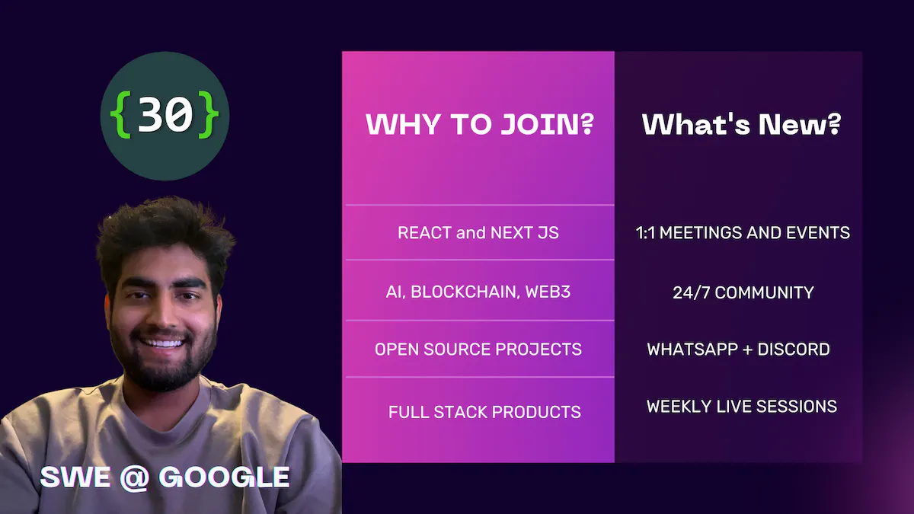
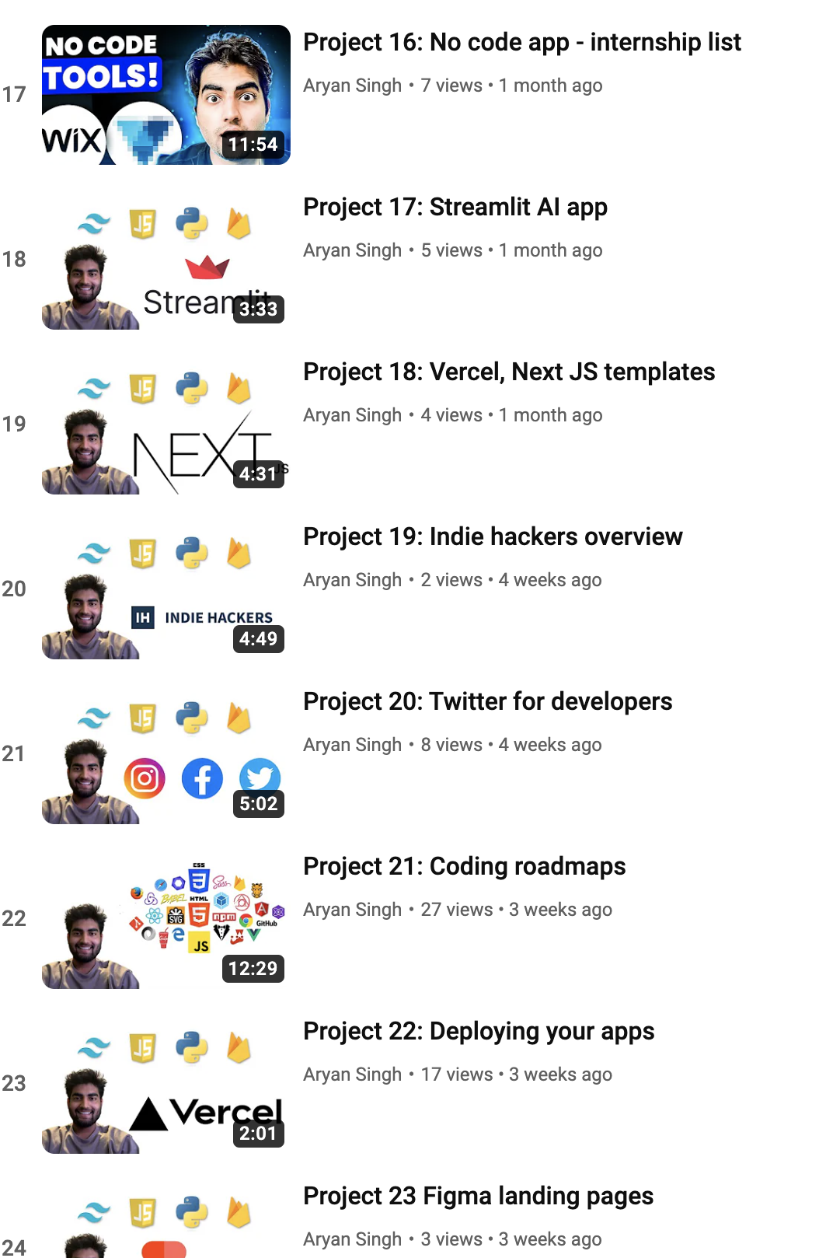
Join the 24/7 community - 30DaysCoding.com
Ask questions anytime
Live events every week
Exclusive projects and live classes
1:1 mentorship sessions

Slide 4
Resume and application process
Resume, cold email, referrals, job boards, remote jobs
30dayscoding.com

Slide 5
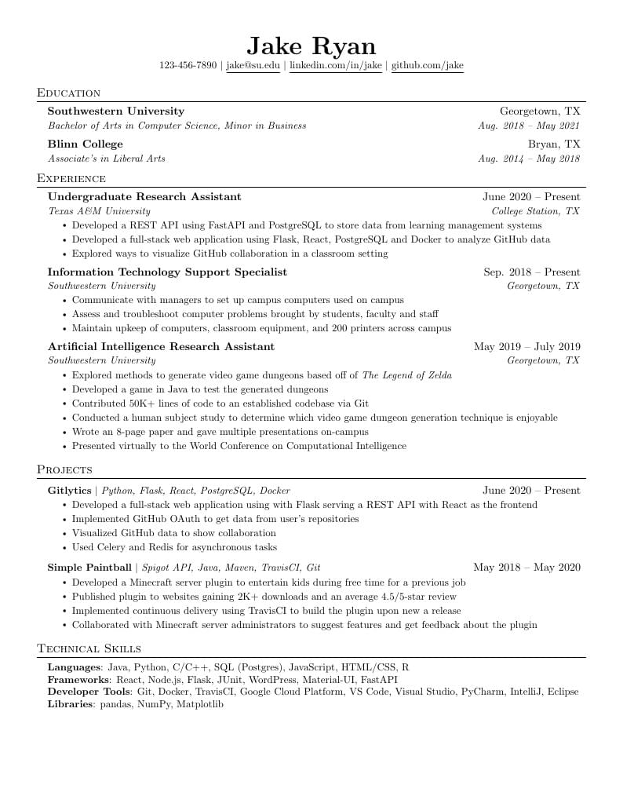
Jake ryan’s resume template
Use this template
https://www.overleaf.com/latex/templates/jakes-resume/syzfjbzwjncs
4 sections
3-4 points
Live links
Github links
NO certificates
No bullshit
Nothing older than college unless super important
DON’T JUST FILL in
Keep it relevant

Slide 6
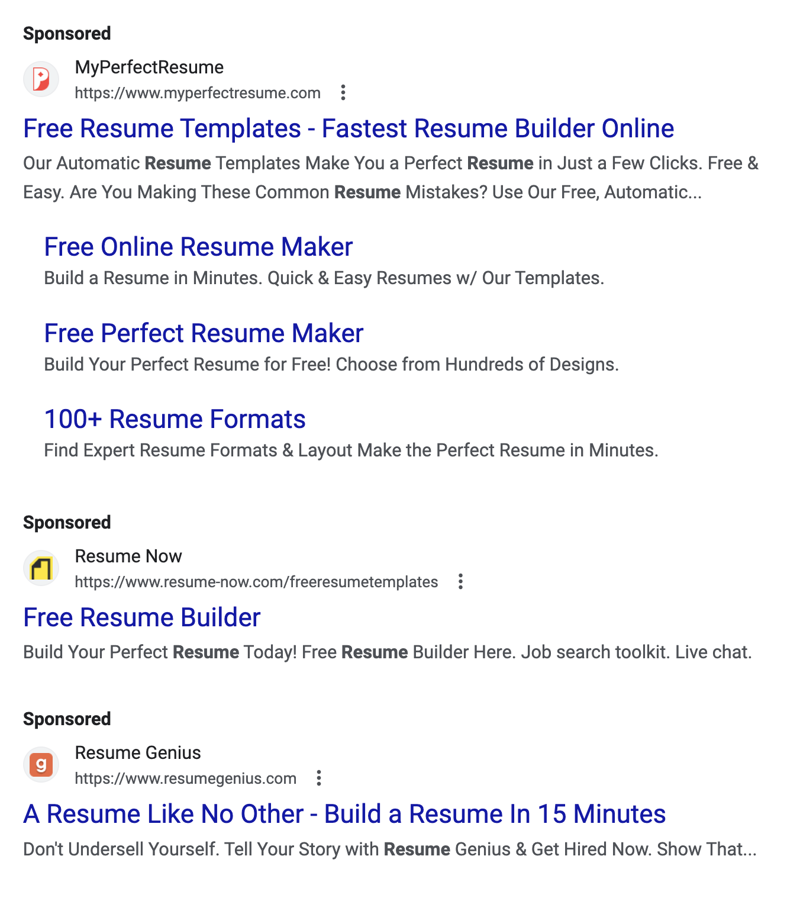
STOP SPENDING HOURS ON TOOLS
Keep it simple
Simple english
Simple points
Learn the basics
The harsh reality is that no one is going to read your resume unless you have something very very impressive

Slide 7
Everything you need!
Stop looking for AI tools or templates
Make a simple resume and start applying
You are not getting opportunities because of your projects, not because your resume is “bad”
Just use the template and work on things that matter
Projects + DSA = 99% of your job application
So move on from the fucking resume PLEASE.

Slide 8
Cold emailing and networking
Coders, freelancers, indie hackers, sellers, etc.
30dayscoding.com

Slide 9
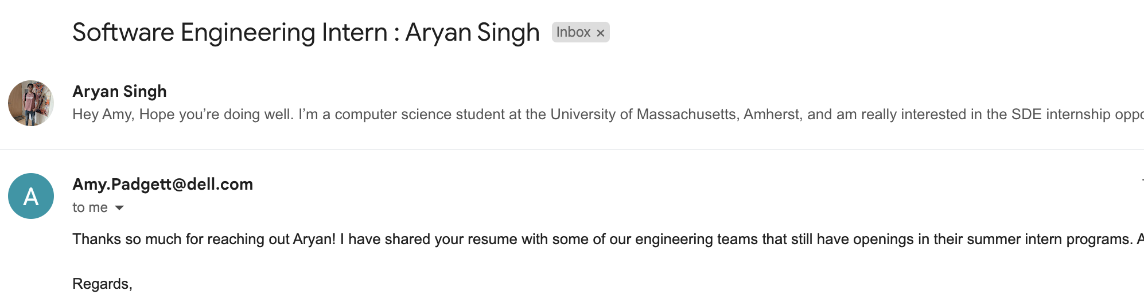
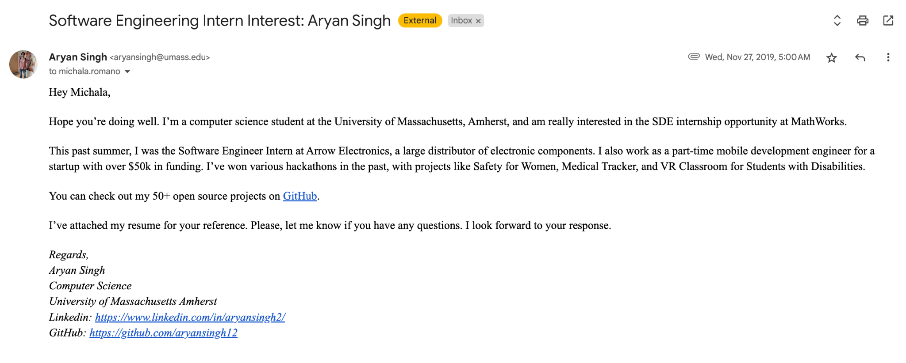
Normal email + emailing when you have another offer
Use the offer
Use the details
Use the tricks
Fasten the process

Slide 10
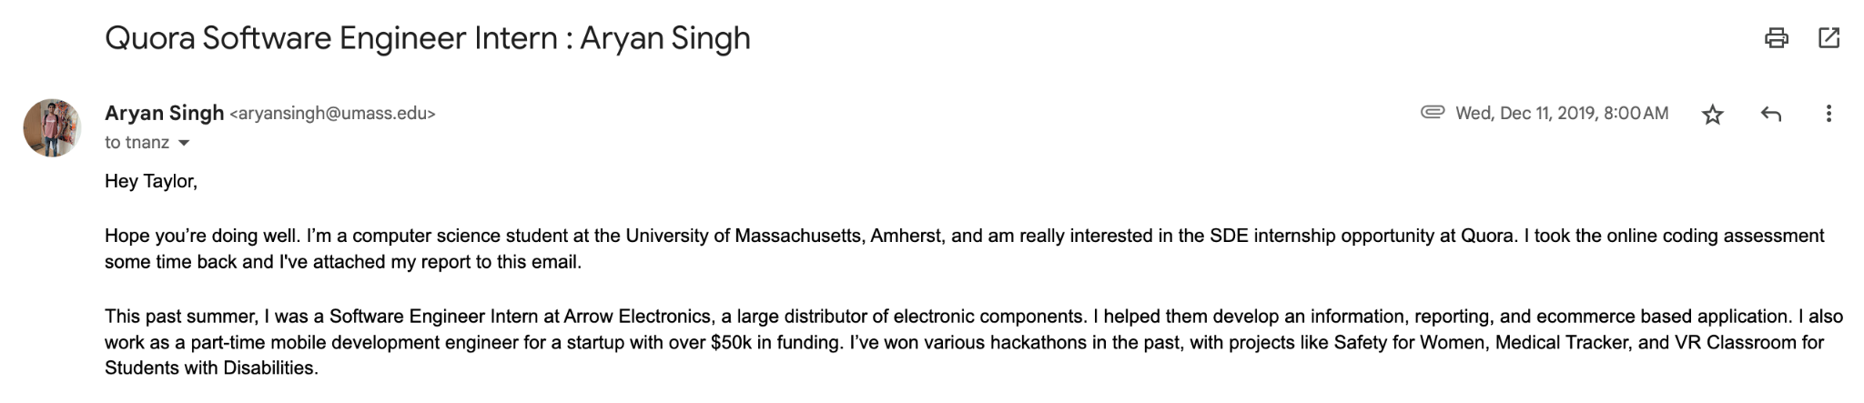
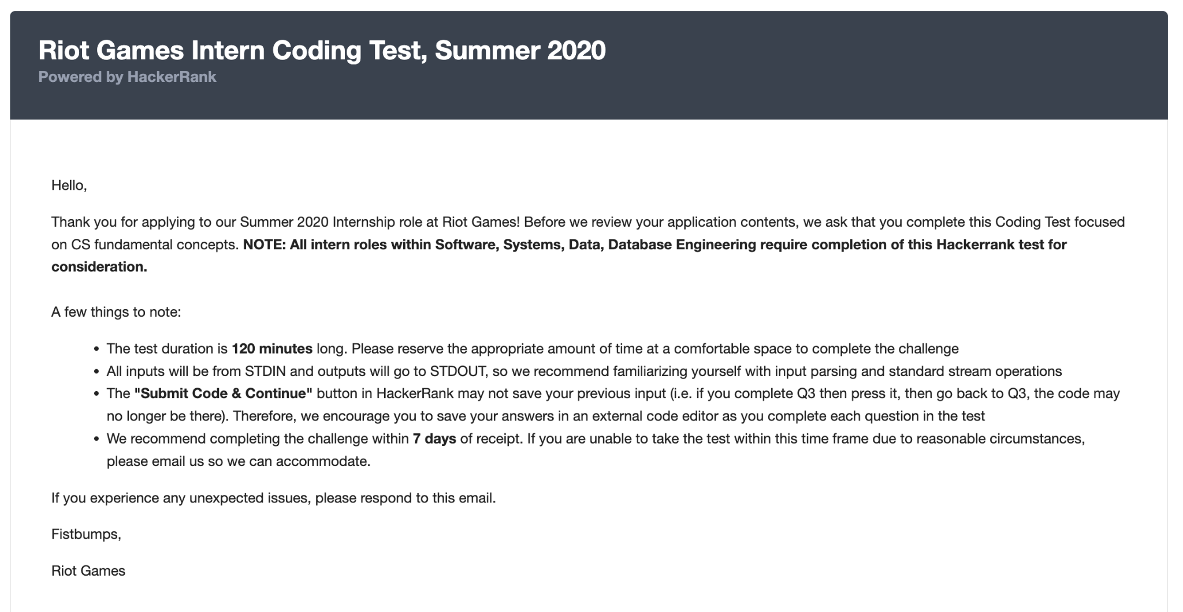
Heading
Description
Test details
Test results
Aim of the email
Result of the email
Keep it simple
Provide value
Concise

Slide 11
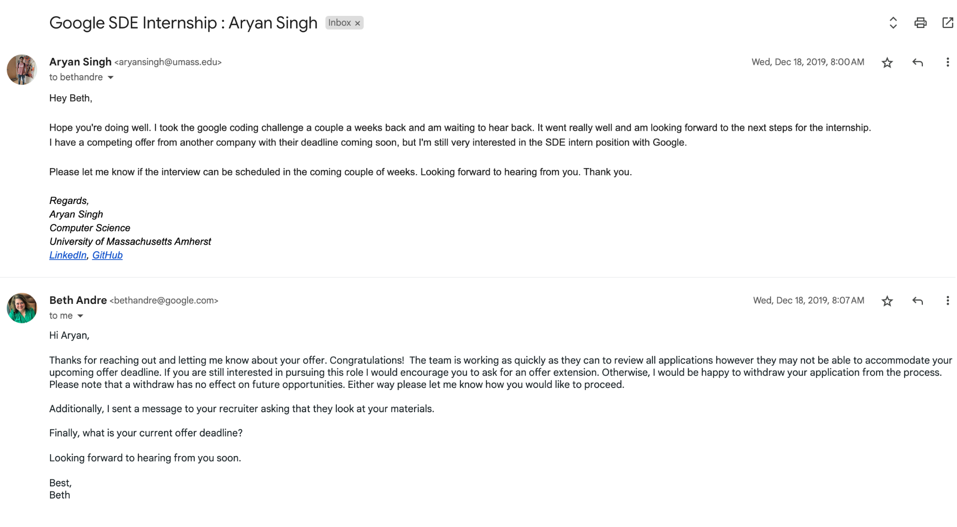

Slide 12
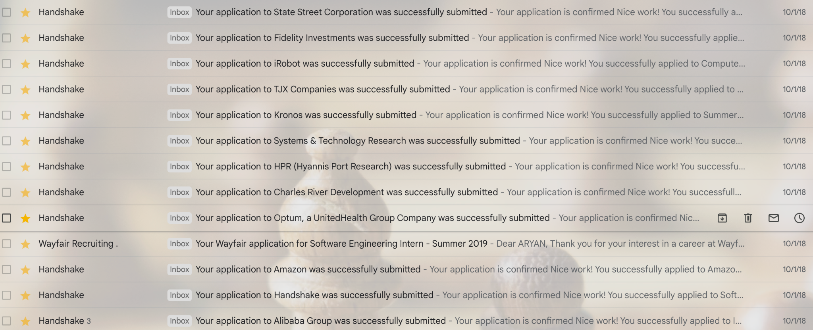
Using a software tool like indeed, handshake, etc is NOT A GOOD PRACTICE.
Look at this example
10000s of people are applying this way
Very slow and outdated

Slide 13
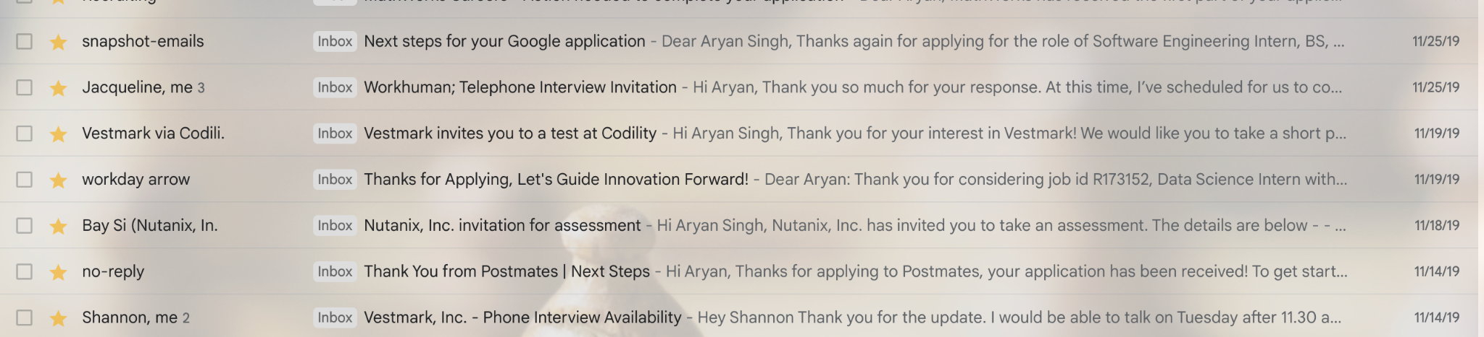
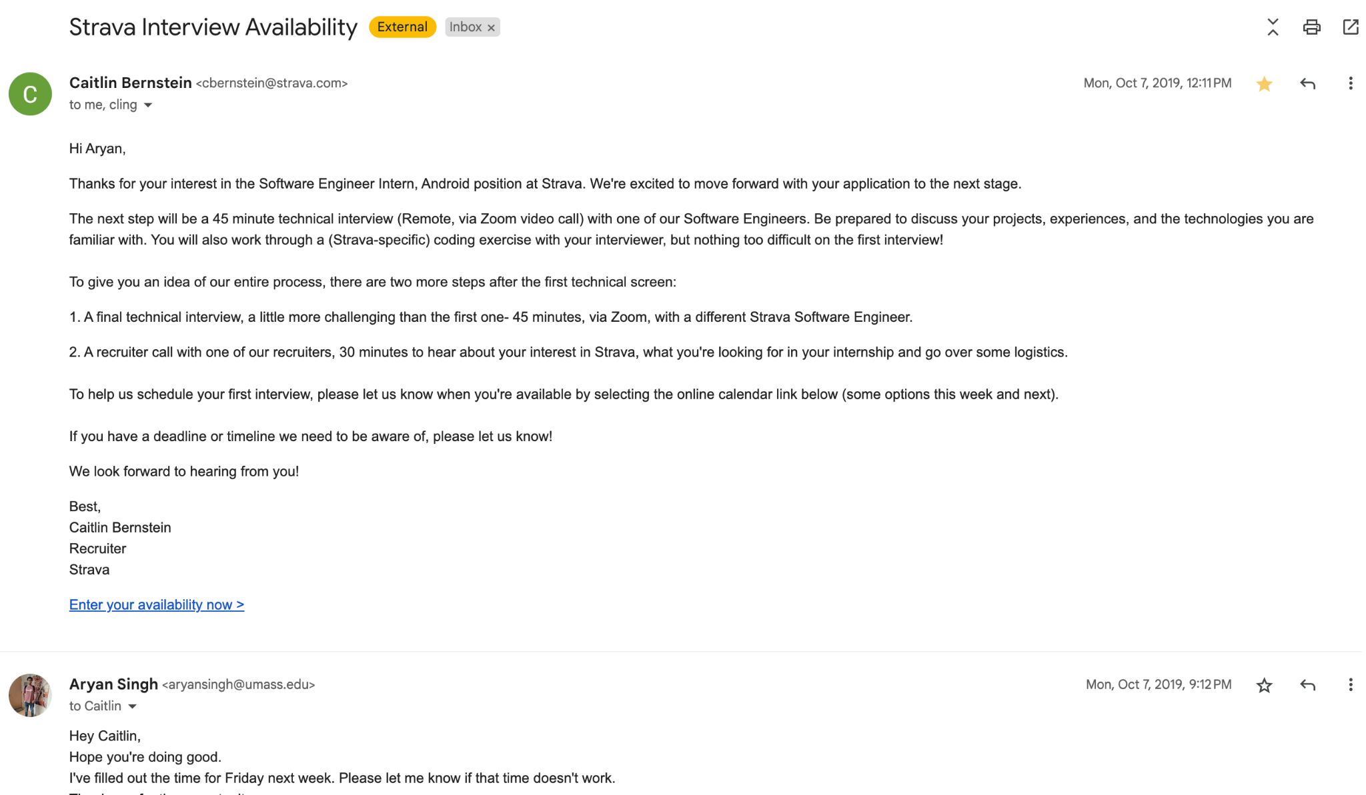
Don’t stop at 1 email
Email 100s of recruiters
Ask for their calls and numbers
Schedule a call if possible
Ask for multiple recruiters
Acceptance rate is usually low

Slide 14
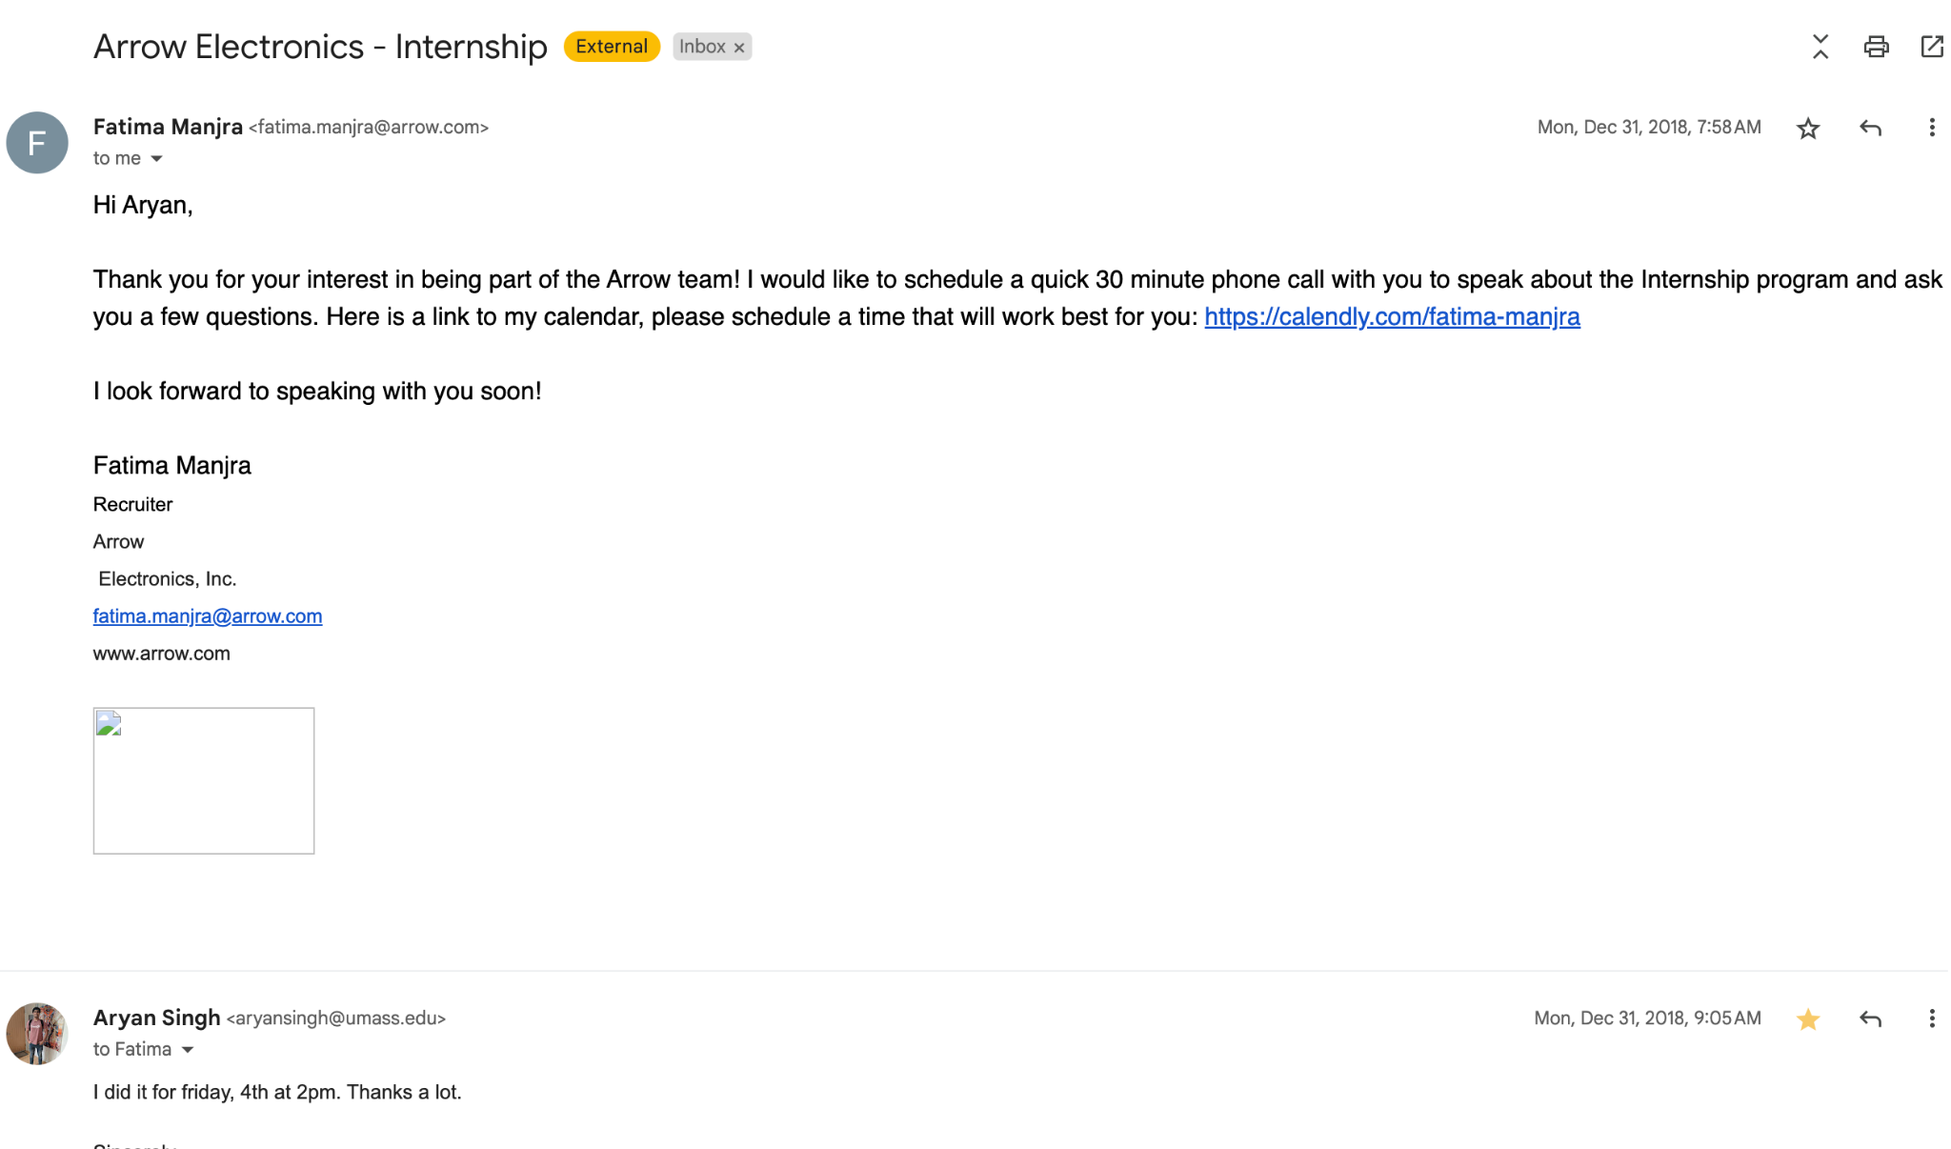

Slide 15
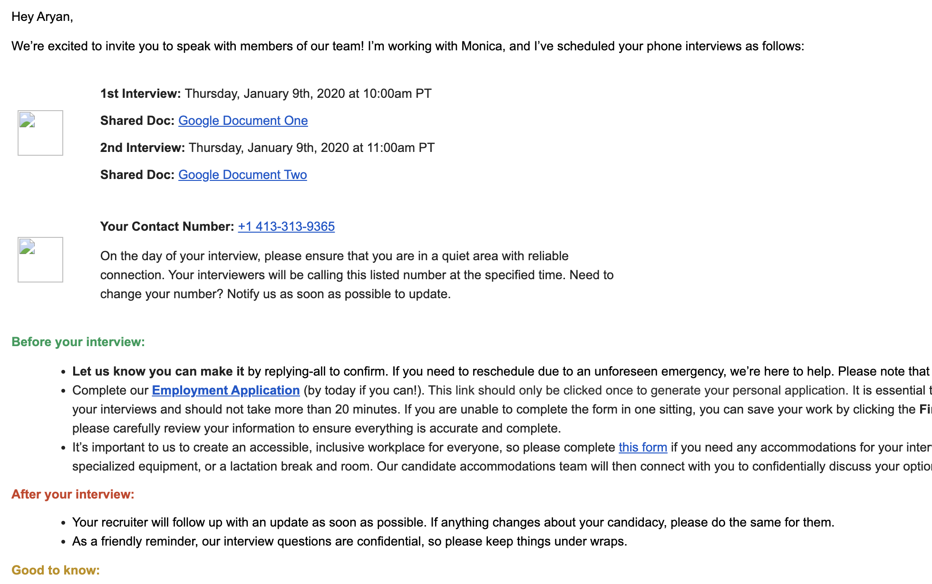
Test yourself with this email response
How will you reply
What will you say
Think about:
What do we want next
Simple and straightforward
Good n bad examples

Slide 16
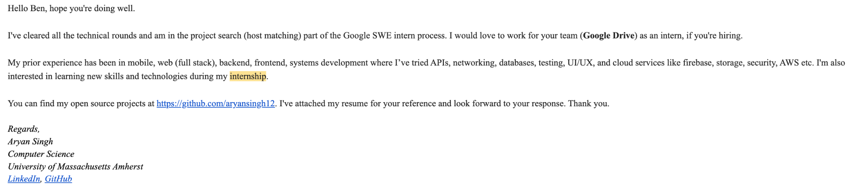
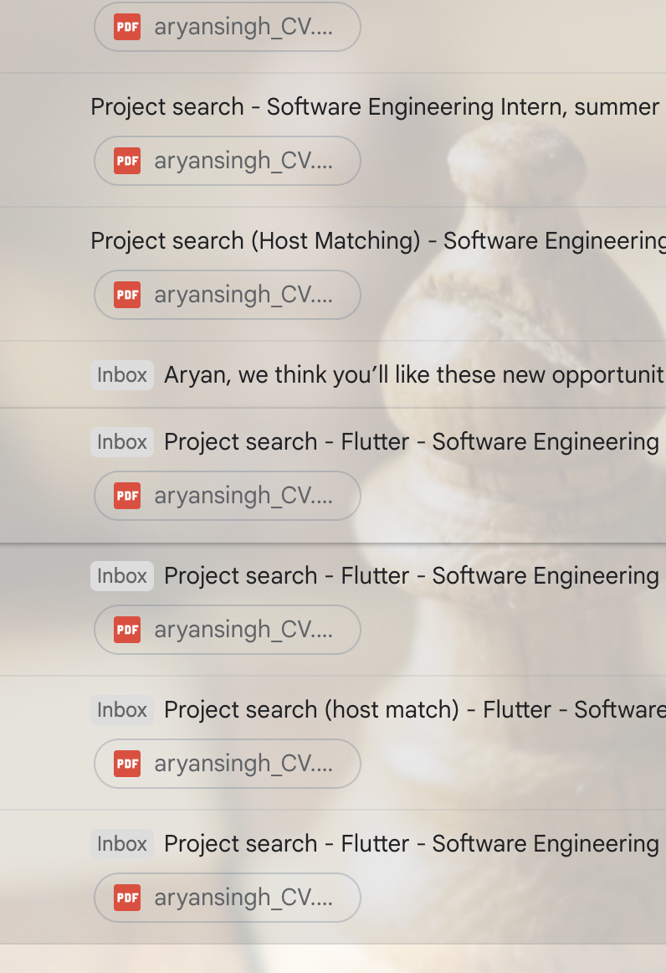
My email for TEAM MATCHING at Google
After my selection
To find a team
Email 50+ people
So many people wait and get rejected in this round. This is how you become better than others.

Slide 17
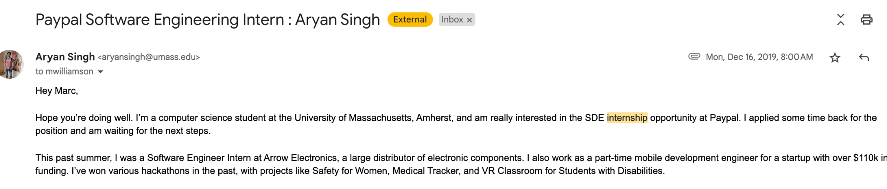
“Applied sometime back”
Revisit the emails
Email them again
Ask for feedback
Ask for updates
Ask for timelines

Slide 18
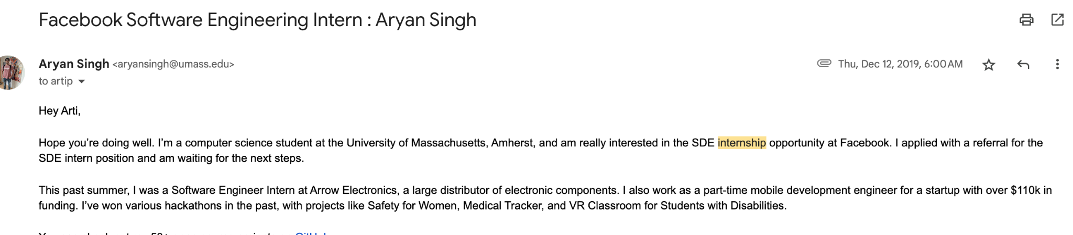
“I’ve applied with referral already”
Tell this to recruiter
Don’t wait and watch
Alert them before others
You need very STRONG POINTS

Slide 19
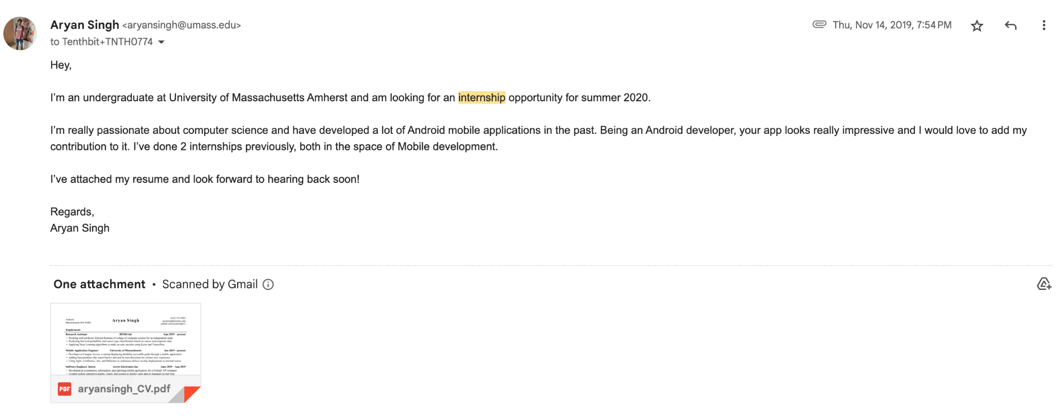
Don’t make it TOOOOO SIMPLE.
This is v simple and boring.
No links, github, portfolio, etc. BAD EMAIL

Slide 20
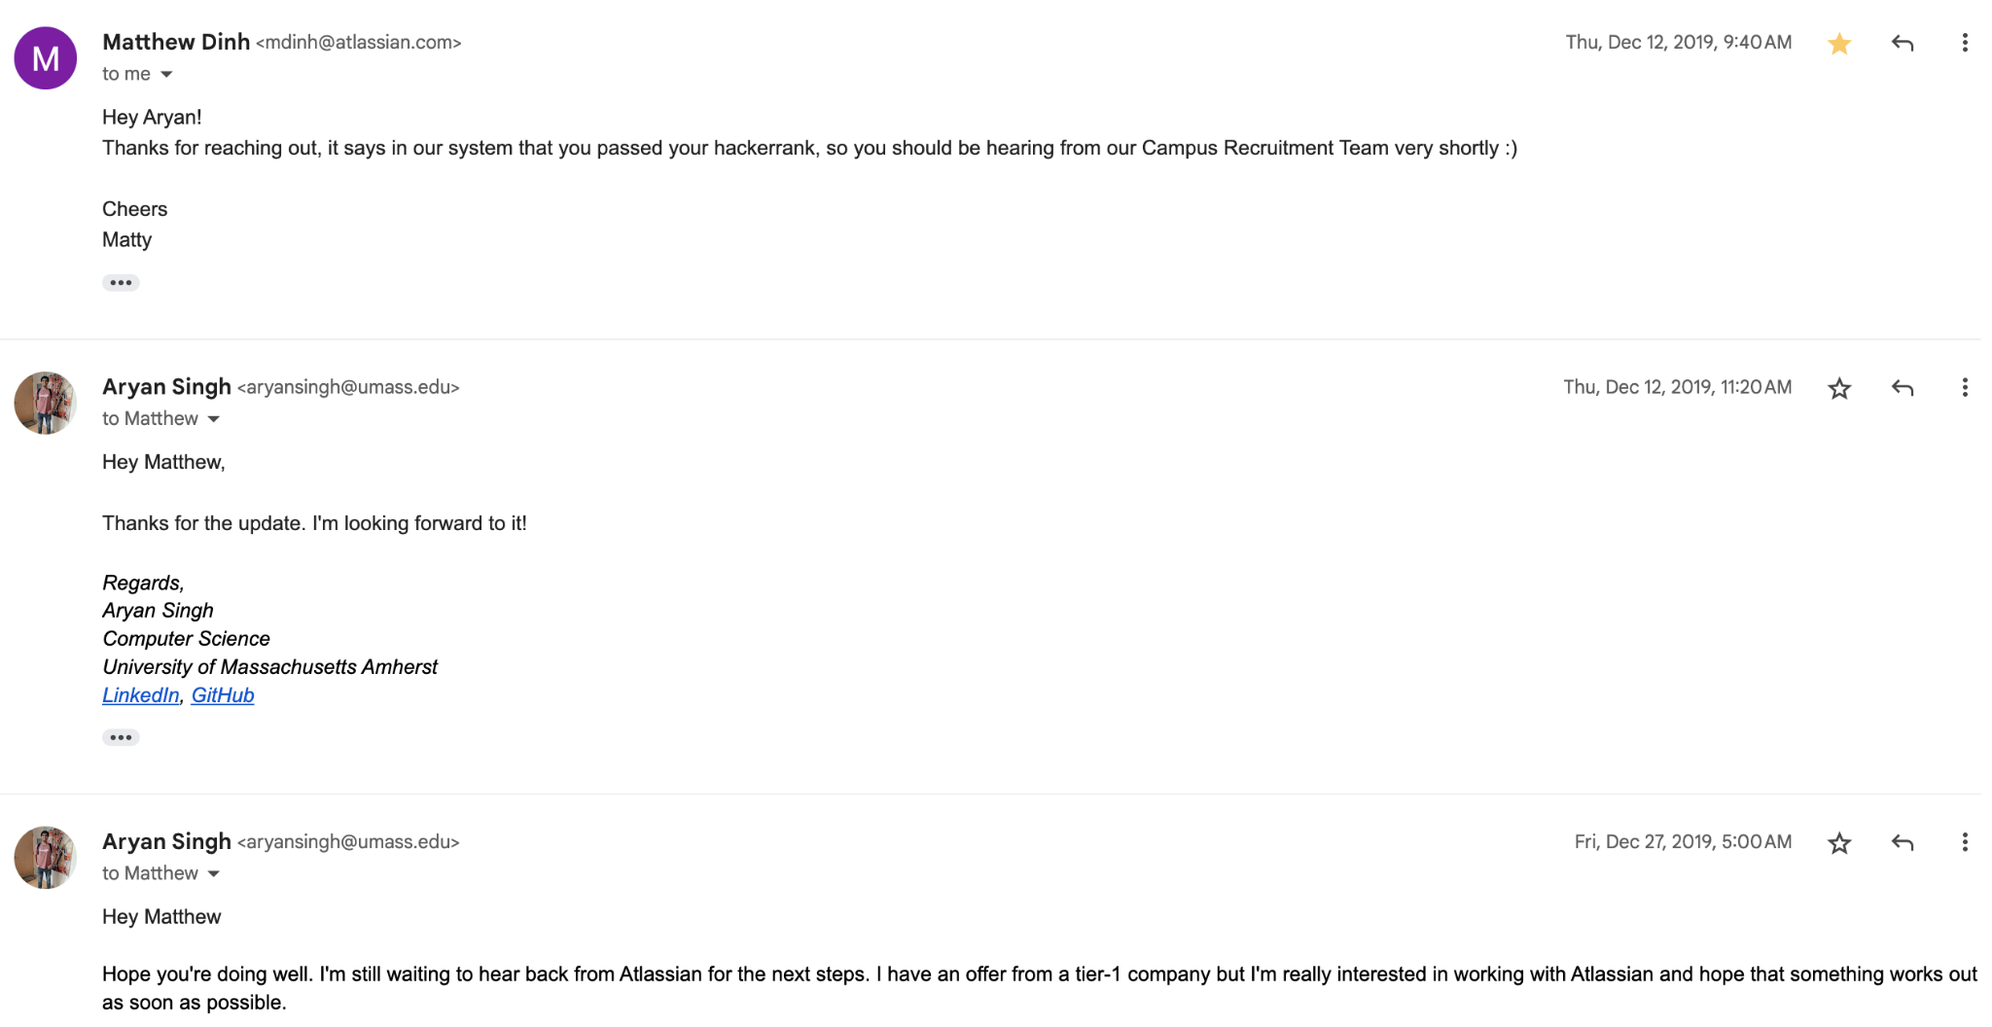
REGULAR FEEDBACK + TIMELINE

Slide 21
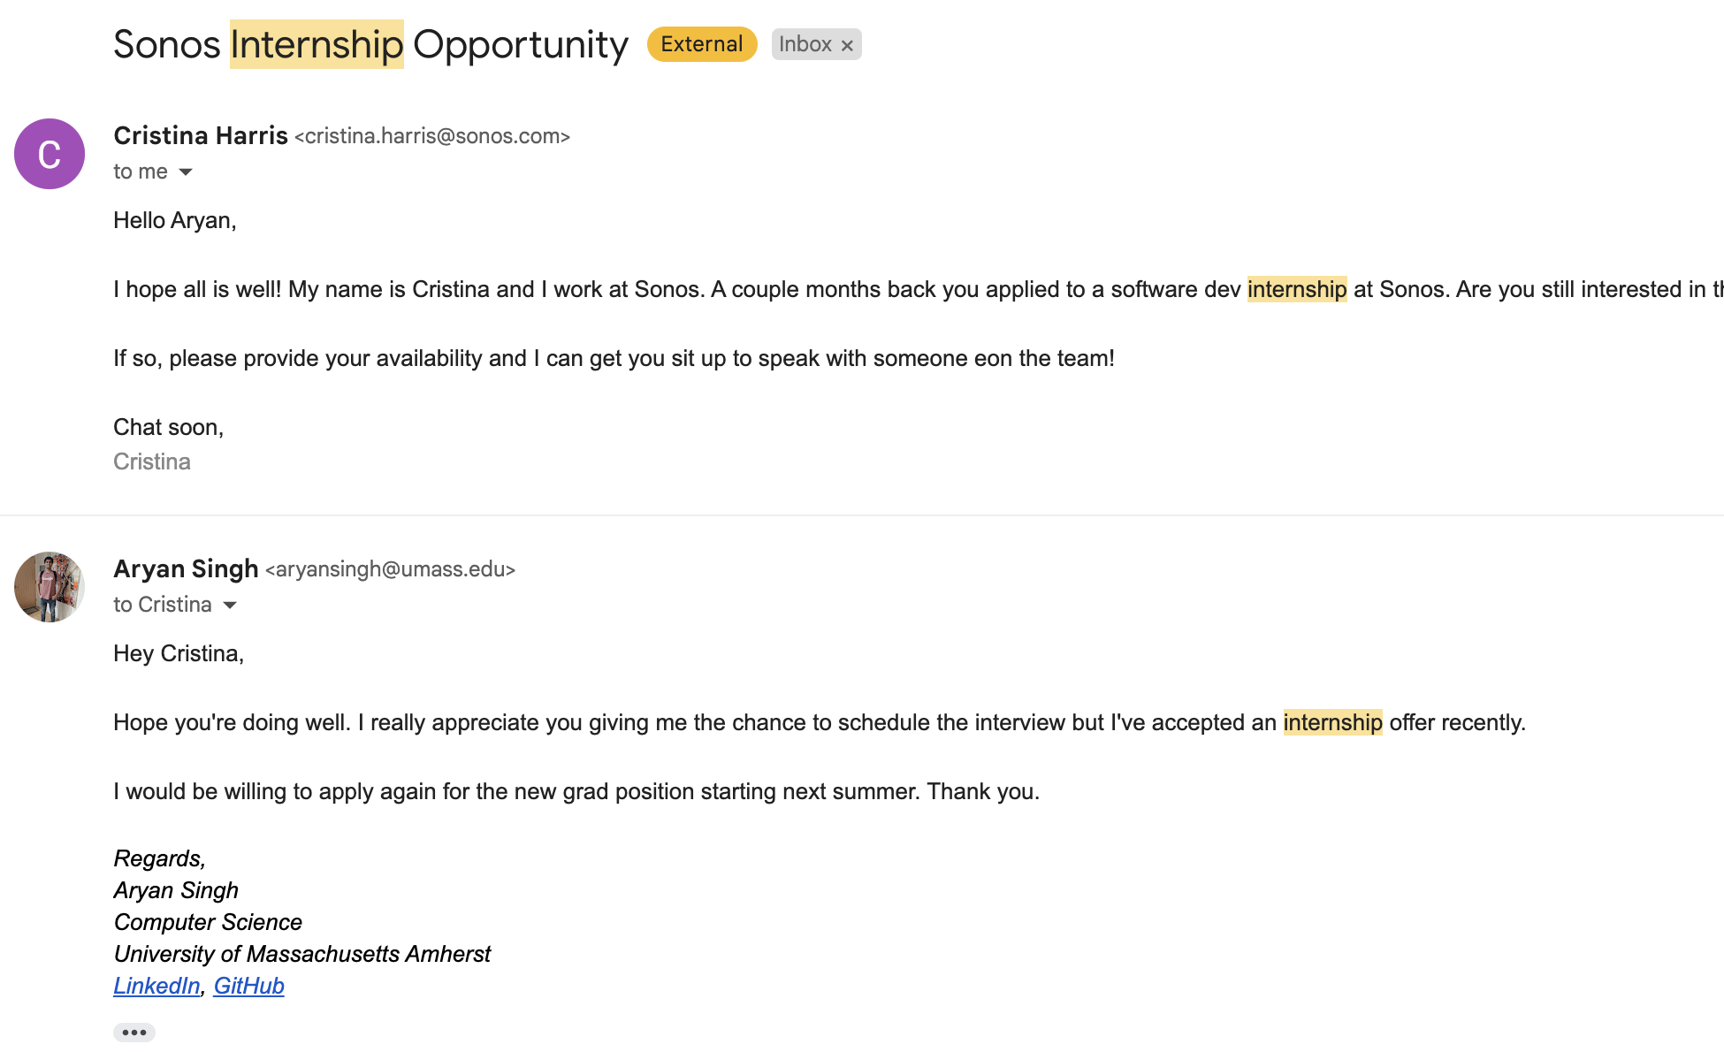
NEVER SAY NO
I said no to internship but still willing to get full time later
Never just say no
I had the google offer so said no
Always
Interview (never know about layoffs)
Ask for personal contact
Keep good relations
Never be rude
Never say no
Always reply even if you don’t ‘have’ to

Slide 22
Resources
https://www.30dayscoding.com/blogs/cold-email
Chat GPT
Try and test
Experiment
Be creative
Be unique
Find YOUR email and find your own journey
Don’t try to find the “BEST” email for you

Slide 23
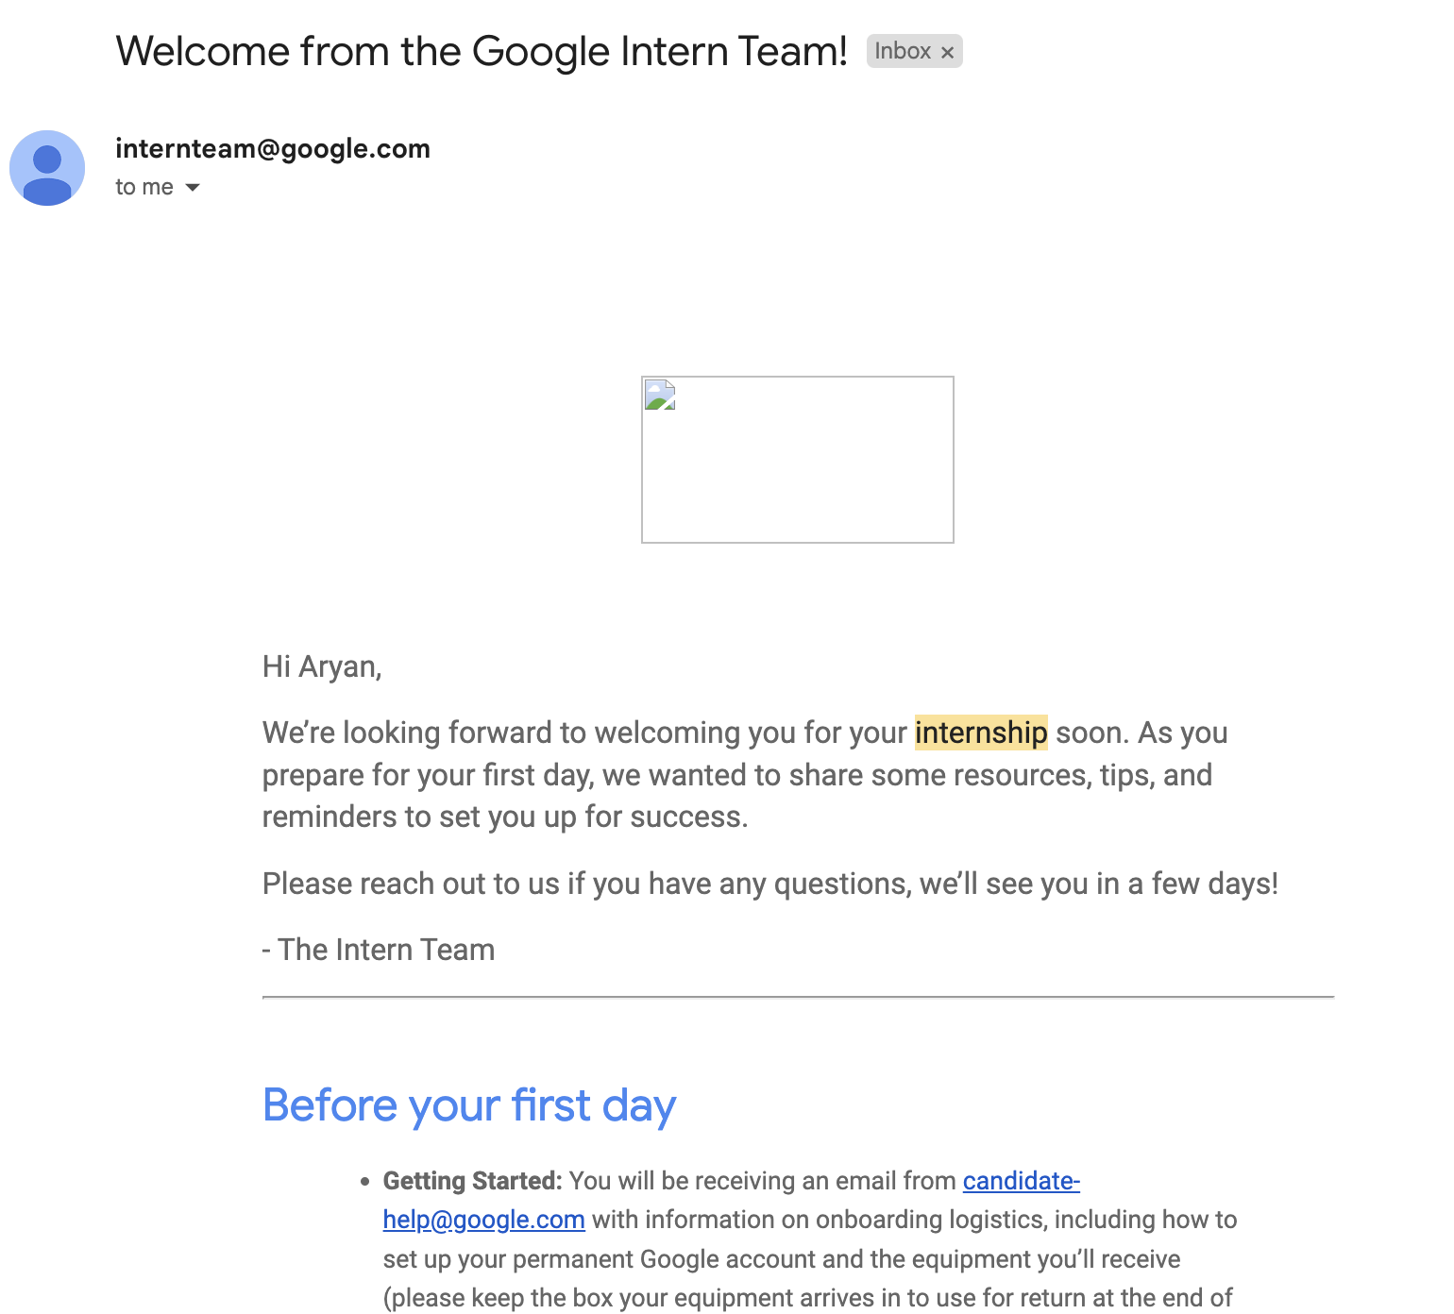
You will see this one day VERY VERY SOON!
Join the community: 30DaysCoding.com for $5/month
Free 1:1 with me
Free resources every week
Free events every week
Amazing people
Exclusive videos and courses

Slide 24
Coding projects + how to build awesome products
Frontend, full stack, Blockchain, AI, etc
30dayscoding.com

Slide 25
Work on your ideas
Do not watch a tutorial unless NEEDED
Find blogs and guides before videos
Find interesting projects
Find new ideas
Work on trending things
Try to make money with projects
Try to turn projects into products
Go to hackathons and build something
Try to win in hackathons
Collaborate with people
Stop building alone all the time
30dayscoding.com

Slide 26
Projects + products I’ve built
GetStartupNews.com : AI-Powered Startup News for Social Media
KontentCreator.com : Turn Your Blogs & Essays into Engaging Social Content
30DaysCoding.com : Curate Coding Resources with Your Knowledge
BlockTrain.info : Web3 Education Website
SEOPlatter.com : Become an SEO Hero with AI
DSArevision.com : Revision and other education guides
BabySaas.com : Agency landing page website
And many more. 20+ domains

Slide 27
5 more projects - explore and see the quality
https://project-erc20.vercel.app/
http://openriver-thirdweb.vercel.app/
https://dopp.vercel.app/
https://dev-pool.vercel.app/
https://guruji.vercel.app/

Slide 28
Learn REACT BEFORE anything else (if you’re confused)
Very high in demand
Lot of packages and libraries
Very easy to make simple projects
Lot of flexibility
Next JS is built on top of it
You become independent developer
You can work on your ideas
Blockchain, AI, etc - everything needs a frontend

Slide 29
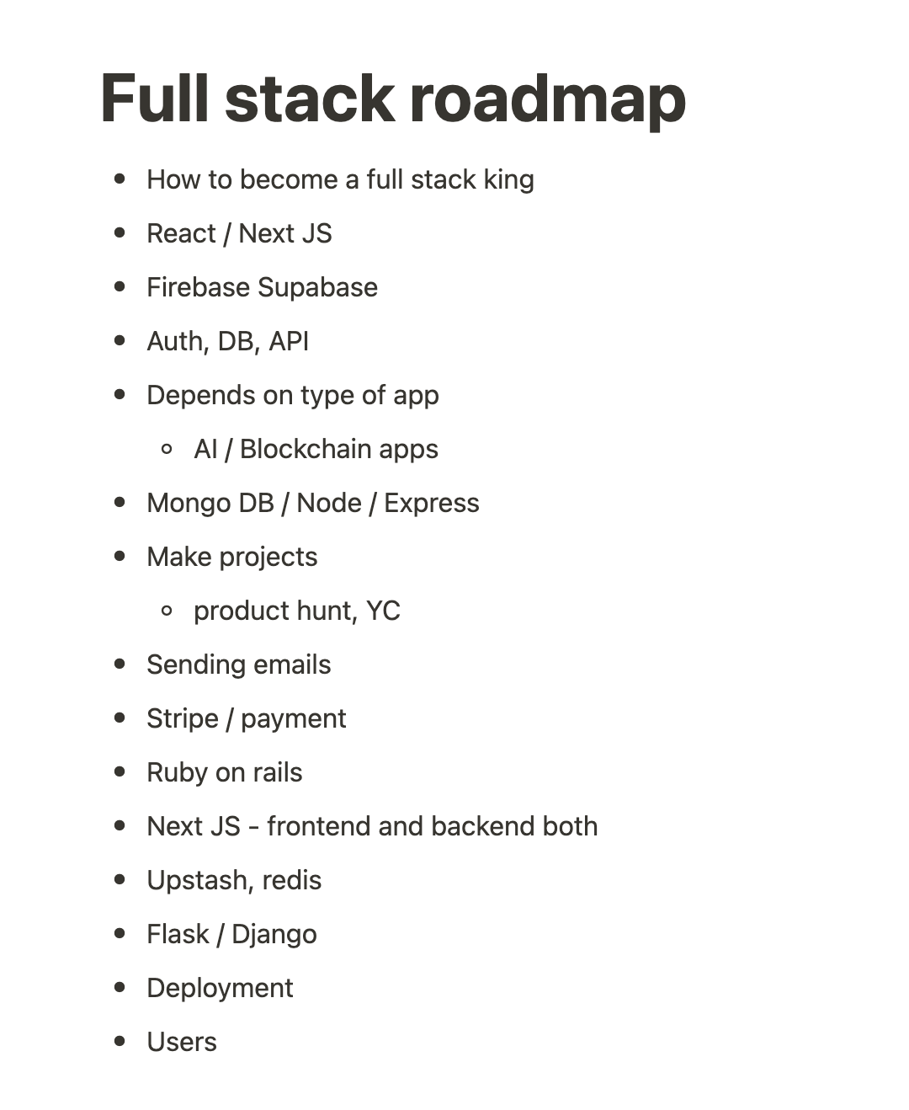
Why do we need projects????
#1
Become independent
Implement ideas
Enjoy coding
Ship products
Make money
#2
Resume
Interviews
Startups
#3
Essence of coding
You learn a lot more

Slide 30
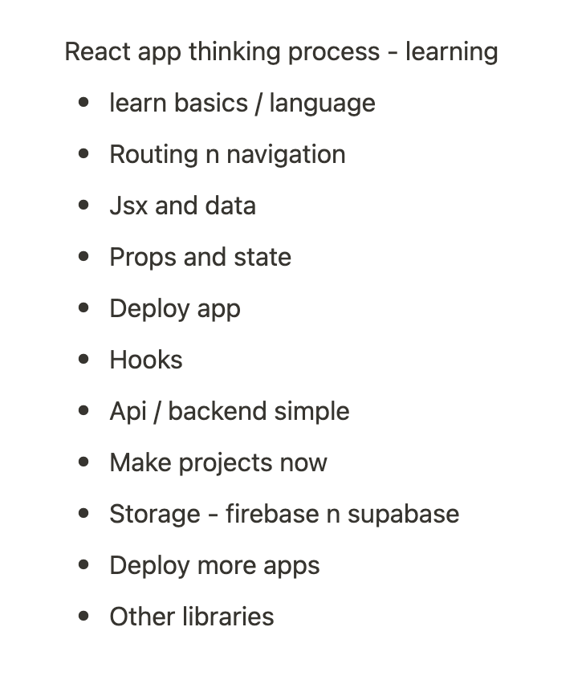
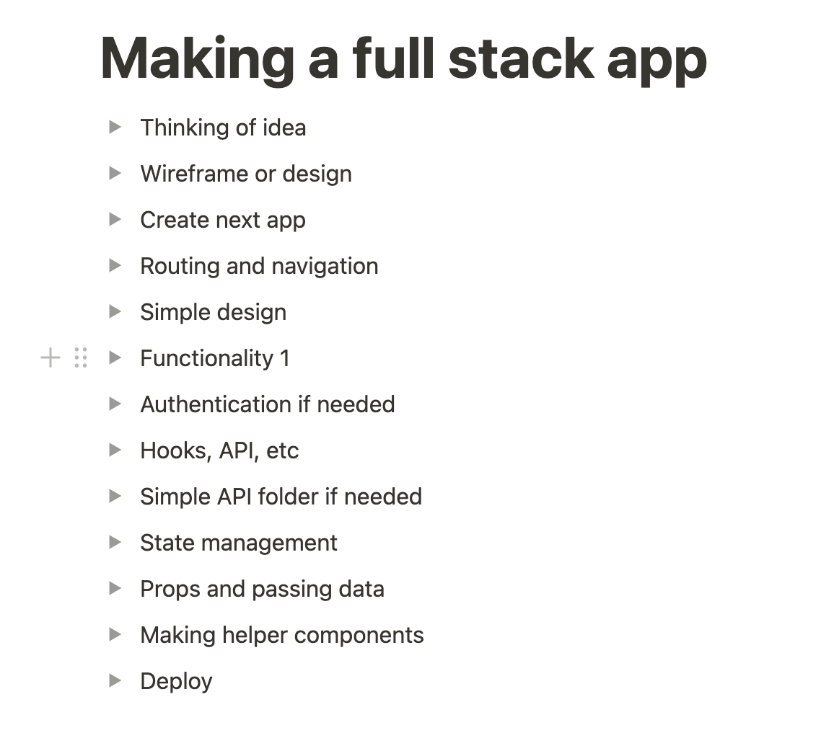
THINK AND THEN GET TO WORK

Slide 31
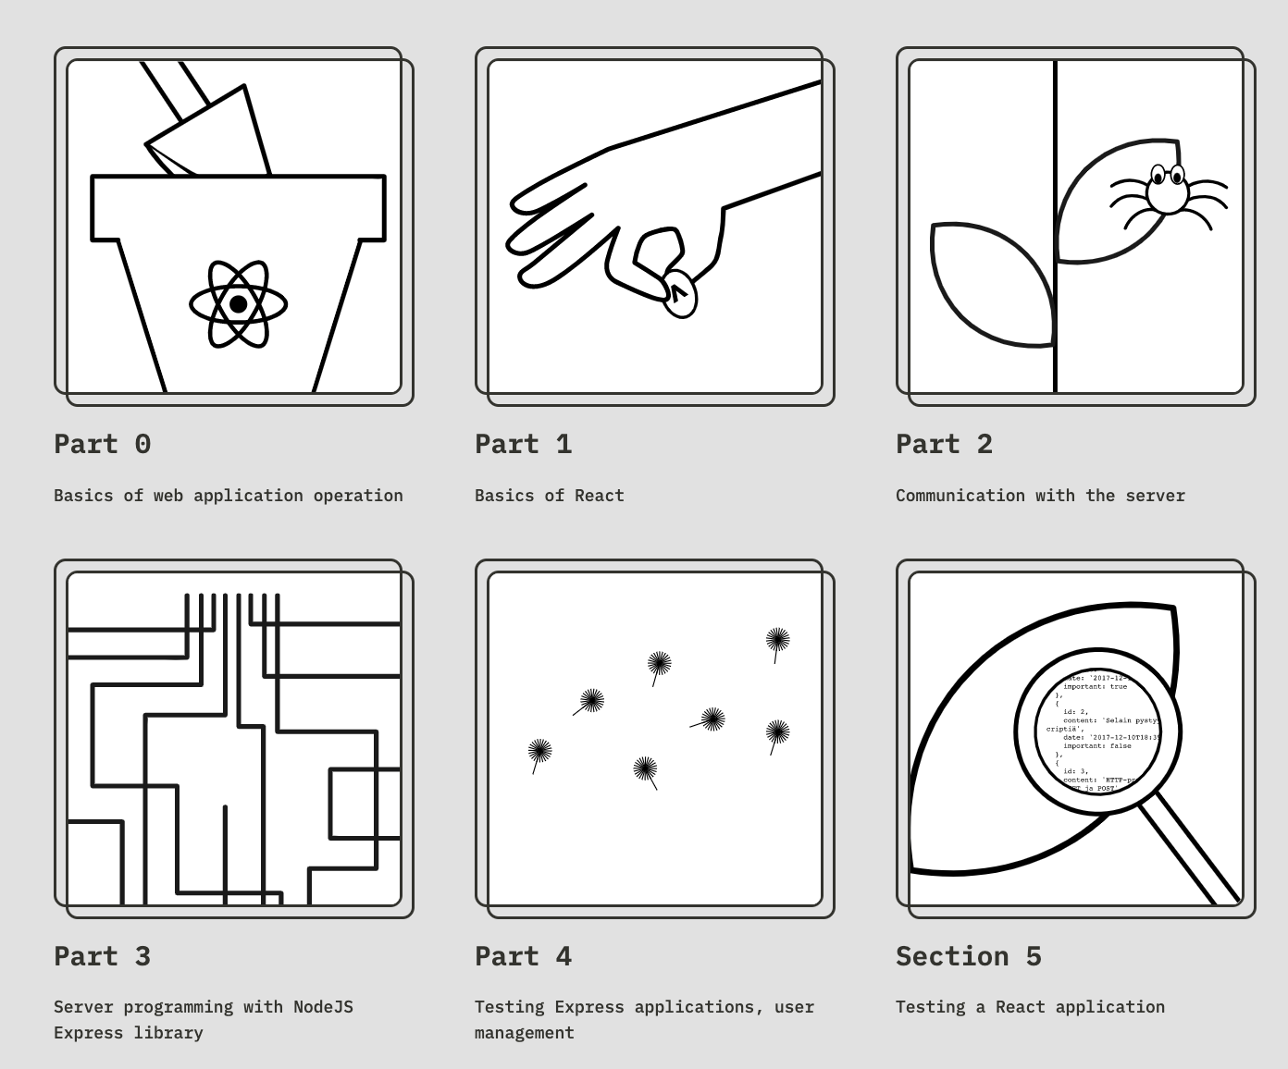
Full stack open Part 1
https://fullstackopen.com/
Complete 6 steps
Basic web dev
React
Node, express
Make apps based on this

Slide 32
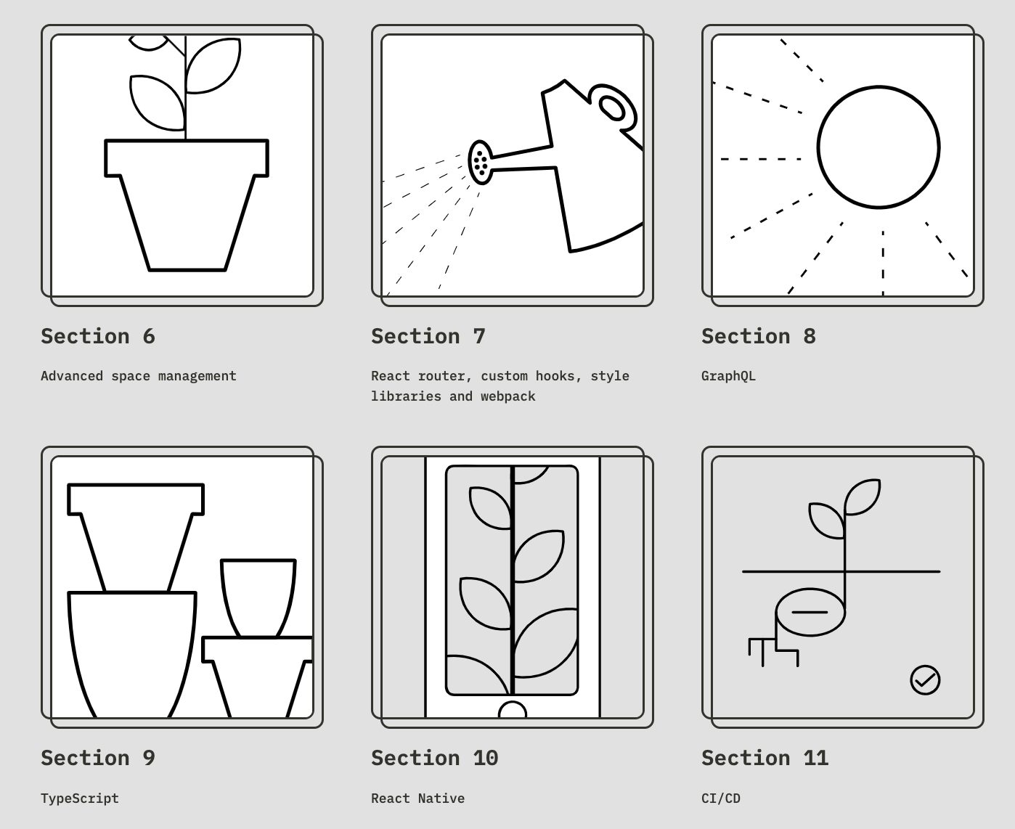
Full stack open Part 2
https://fullstackopen.com/
Complete next 6 steps
Space
Router
Graph QL
Typescript
React Native
CI CD
You can also use
Firebase, supabase, appwrite
Use that and deploy apps

Slide 33
STOP WATCHING ENDLESS TUTORIALS
Start building and shipping - let’s END tutorial hell
30dayscoding.com

Slide 34
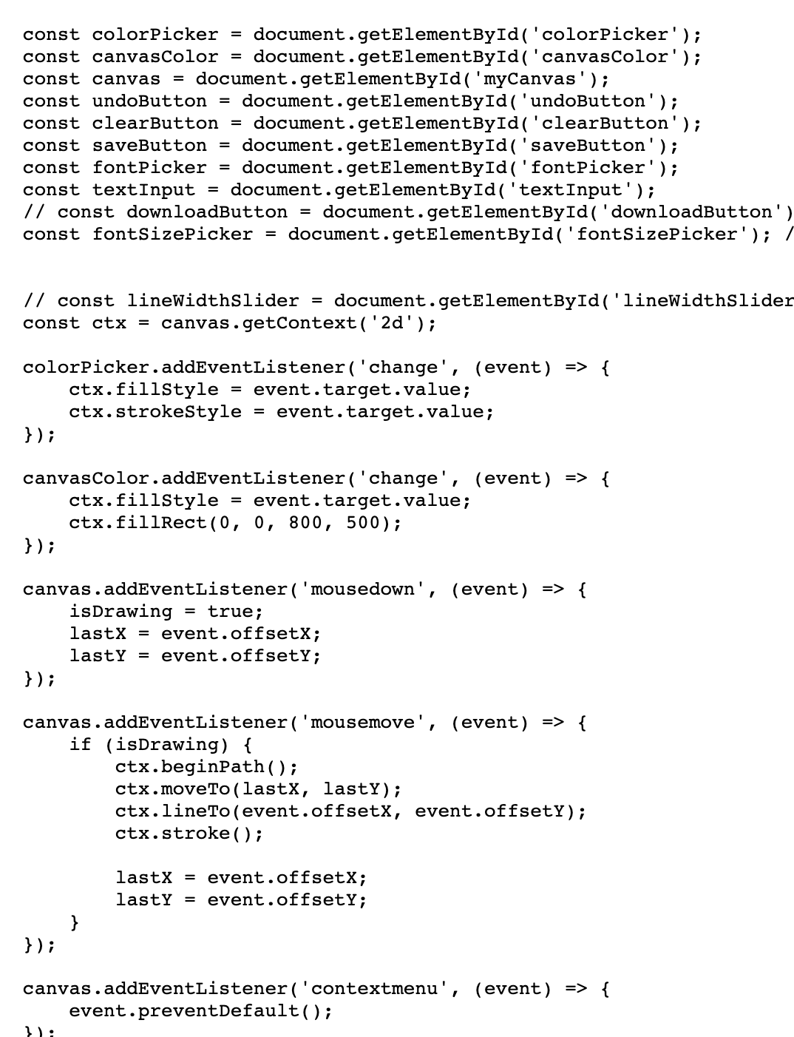
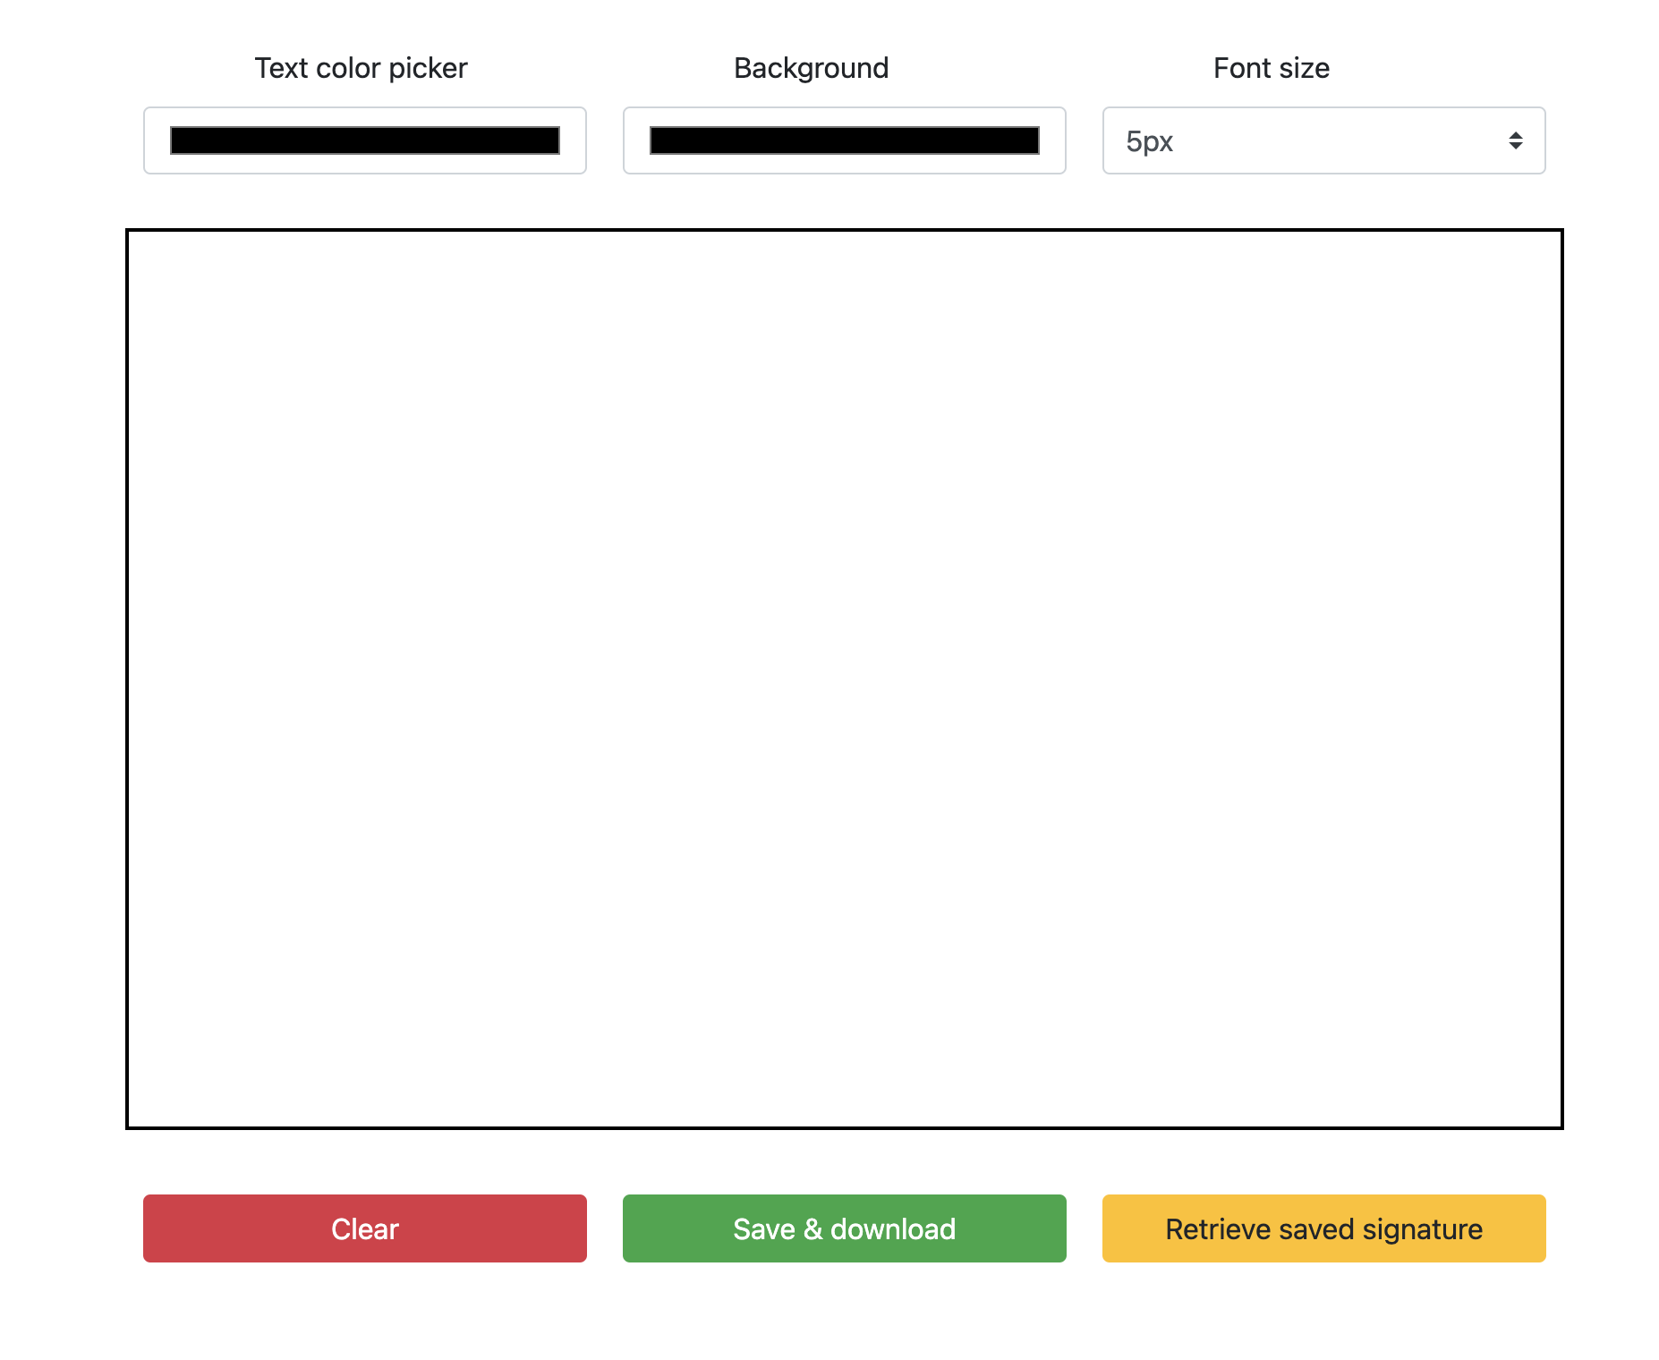
Make projects with Chat GPT - https://quicksign.me/ - learn prompt engineering

Slide 35
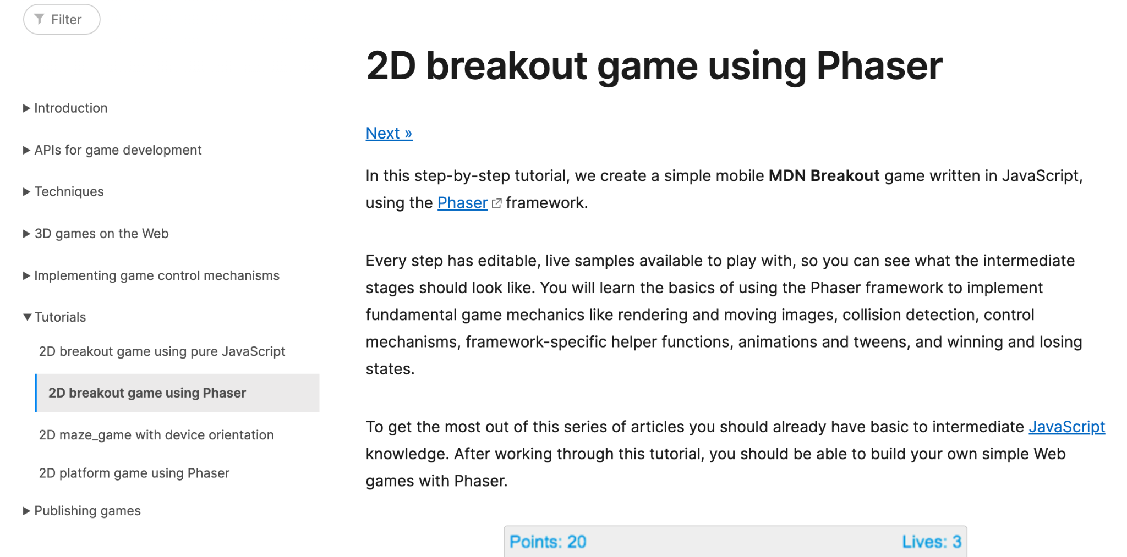
https://developer.mozilla.org/en-US/docs/Games/Tutorials/2D_breakout_game_Phaser
https://developer.mozilla.org/en-US/docs/Games/Tutorials
https://developer.mozilla.org/en-US/docs/Learn/JavaScript
https://www.aha.io/blog/text-editor
READ BLOGS AND GUIDES - stop copying and pasting code from youtube videos without thinking
Reading is much better
You will run into errors
You should change according to your own ideas

Slide 36
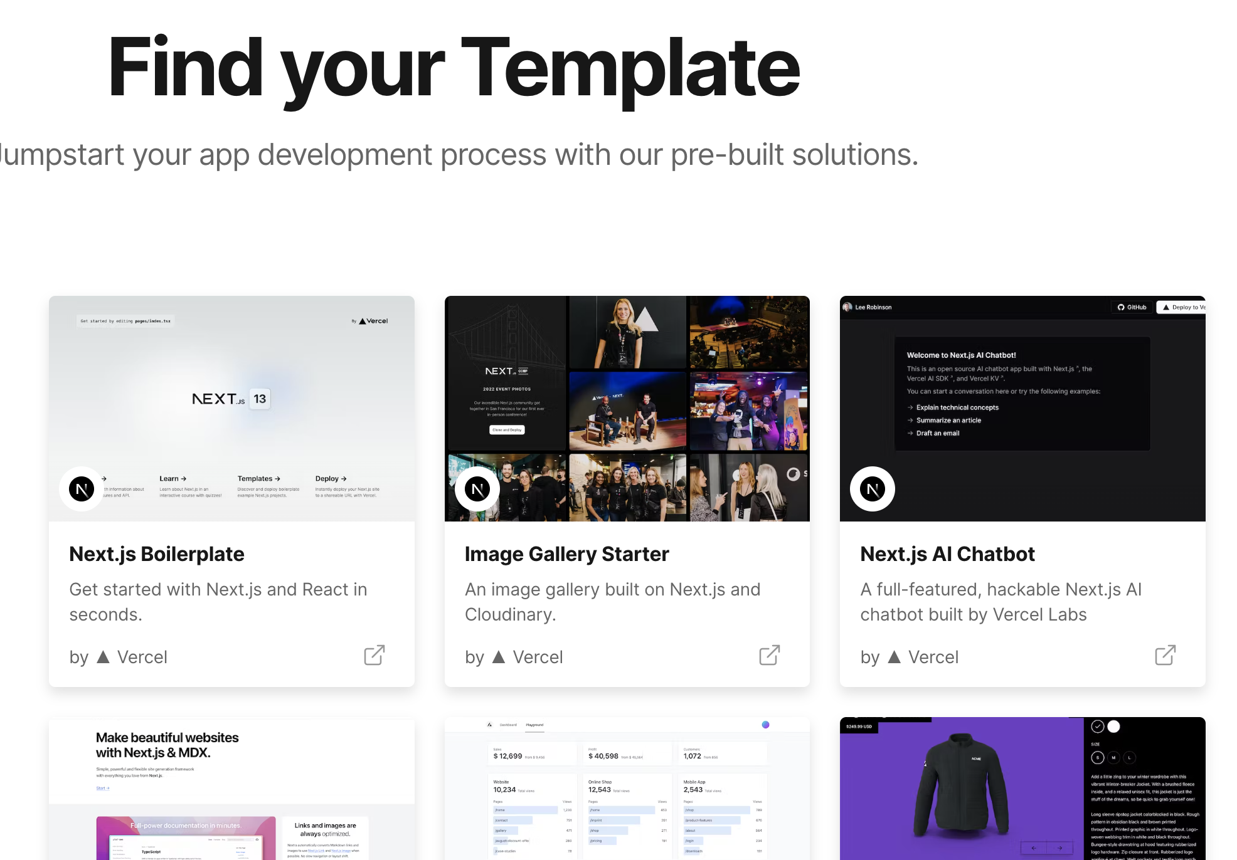
Find a template
https://vercel.com/templates
Implement ideas
Ship fast
Deploy fast
Spread the word
AND THEN
Add features
Add auth
Add other things
THIS WILL CREATE INTEREST

Slide 37
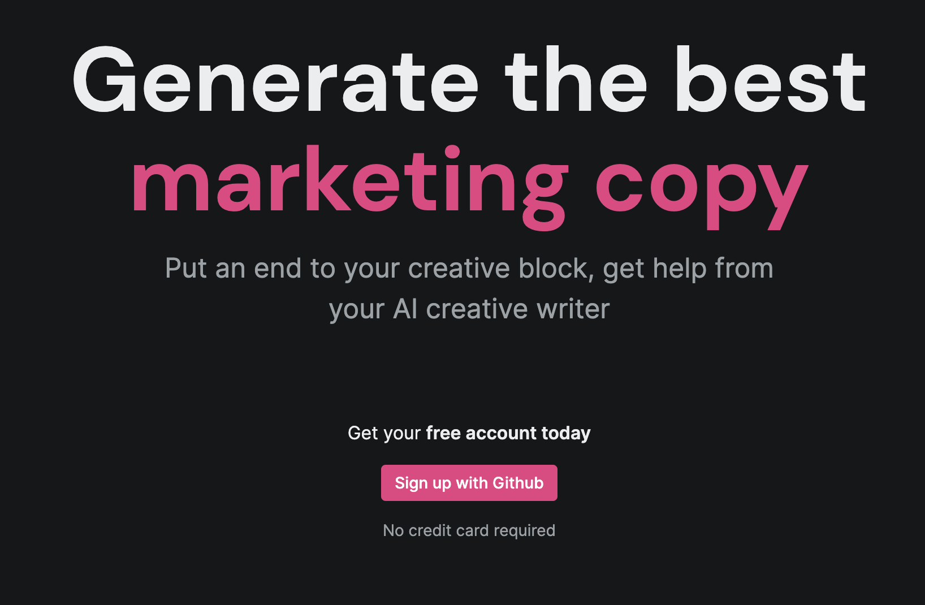
Build this full stack app from the template
https://github.com/tierrun/tier-vercel-openai/tree/main
Add your features
Add something else
Add a tadka taste
Some ideas
Traveling, calories, fitness, jobs, etc with AI
Join the community to find such awesome projects every week with exclusive projects - 30dayscoding.com

Slide 38
STEPS TO ELIMINATE TUTORIAL HELL AND SHIP FAST
Work on your ideas
Do not watch a tutorial unless NEEDED
Find blogs and guides before videos
Find interesting projects
Find new ideas
Work on trending things
Try to make money with projects
Try to turn projects into products
Go to hackathons and build something
Try to win in hackathons
Collaborate with people
Stop building alone all the time
30dayscoding.com

Slide 39
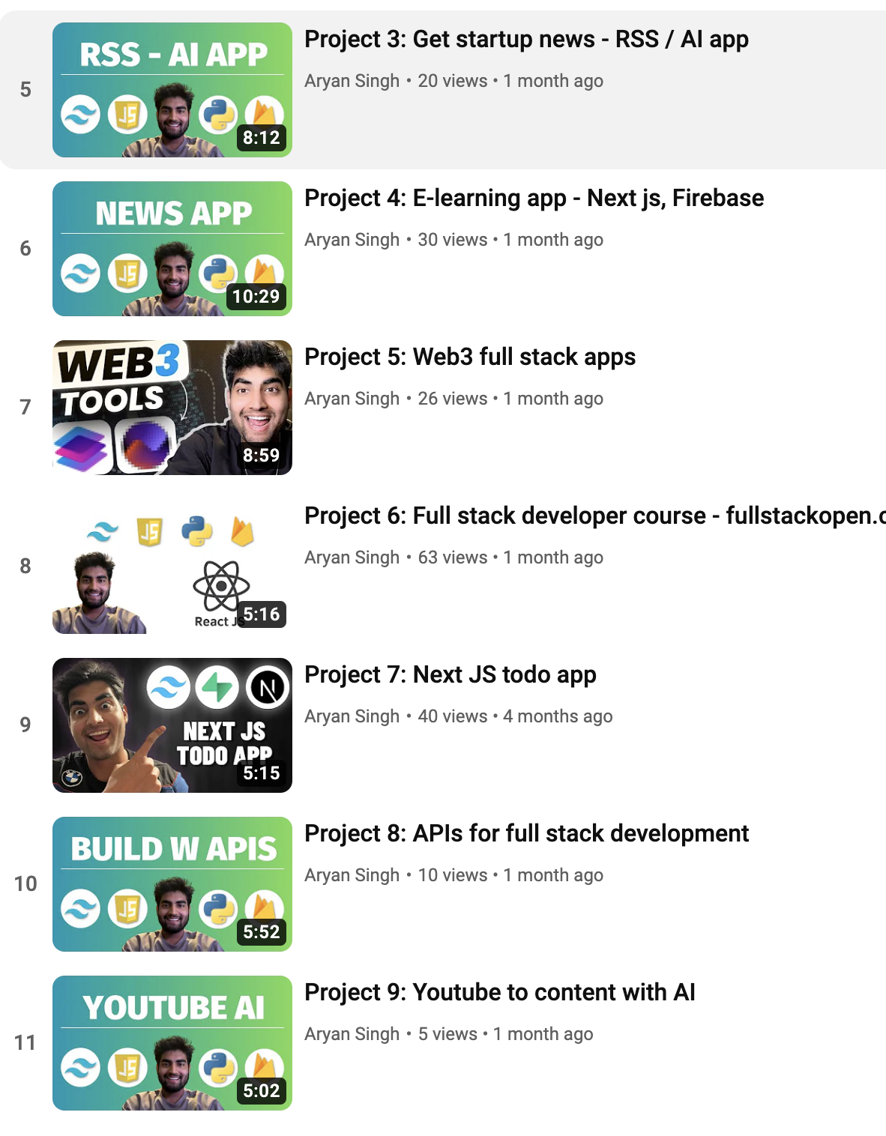

Slide 40
Finding ideas and existing projects
Frontend, full stack, Blockchain, AI, etc
30dayscoding.com

Slide 41
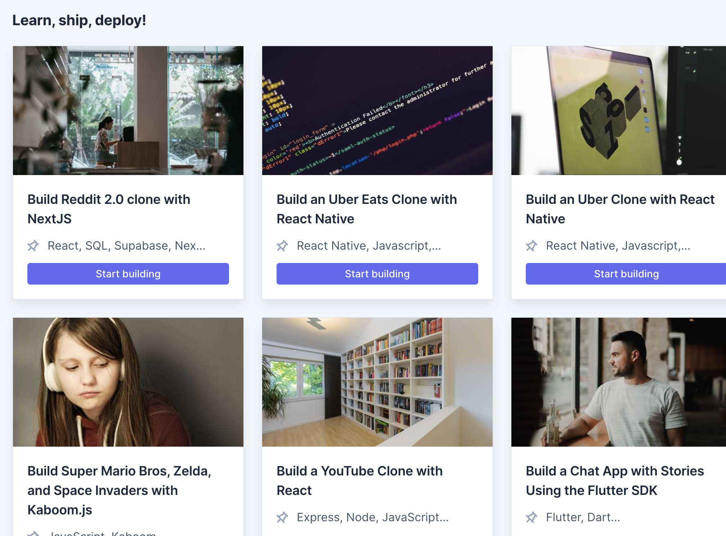
Unlimited projects and ideas
30 days coding website
Chat gpt
Your problems

Slide 42
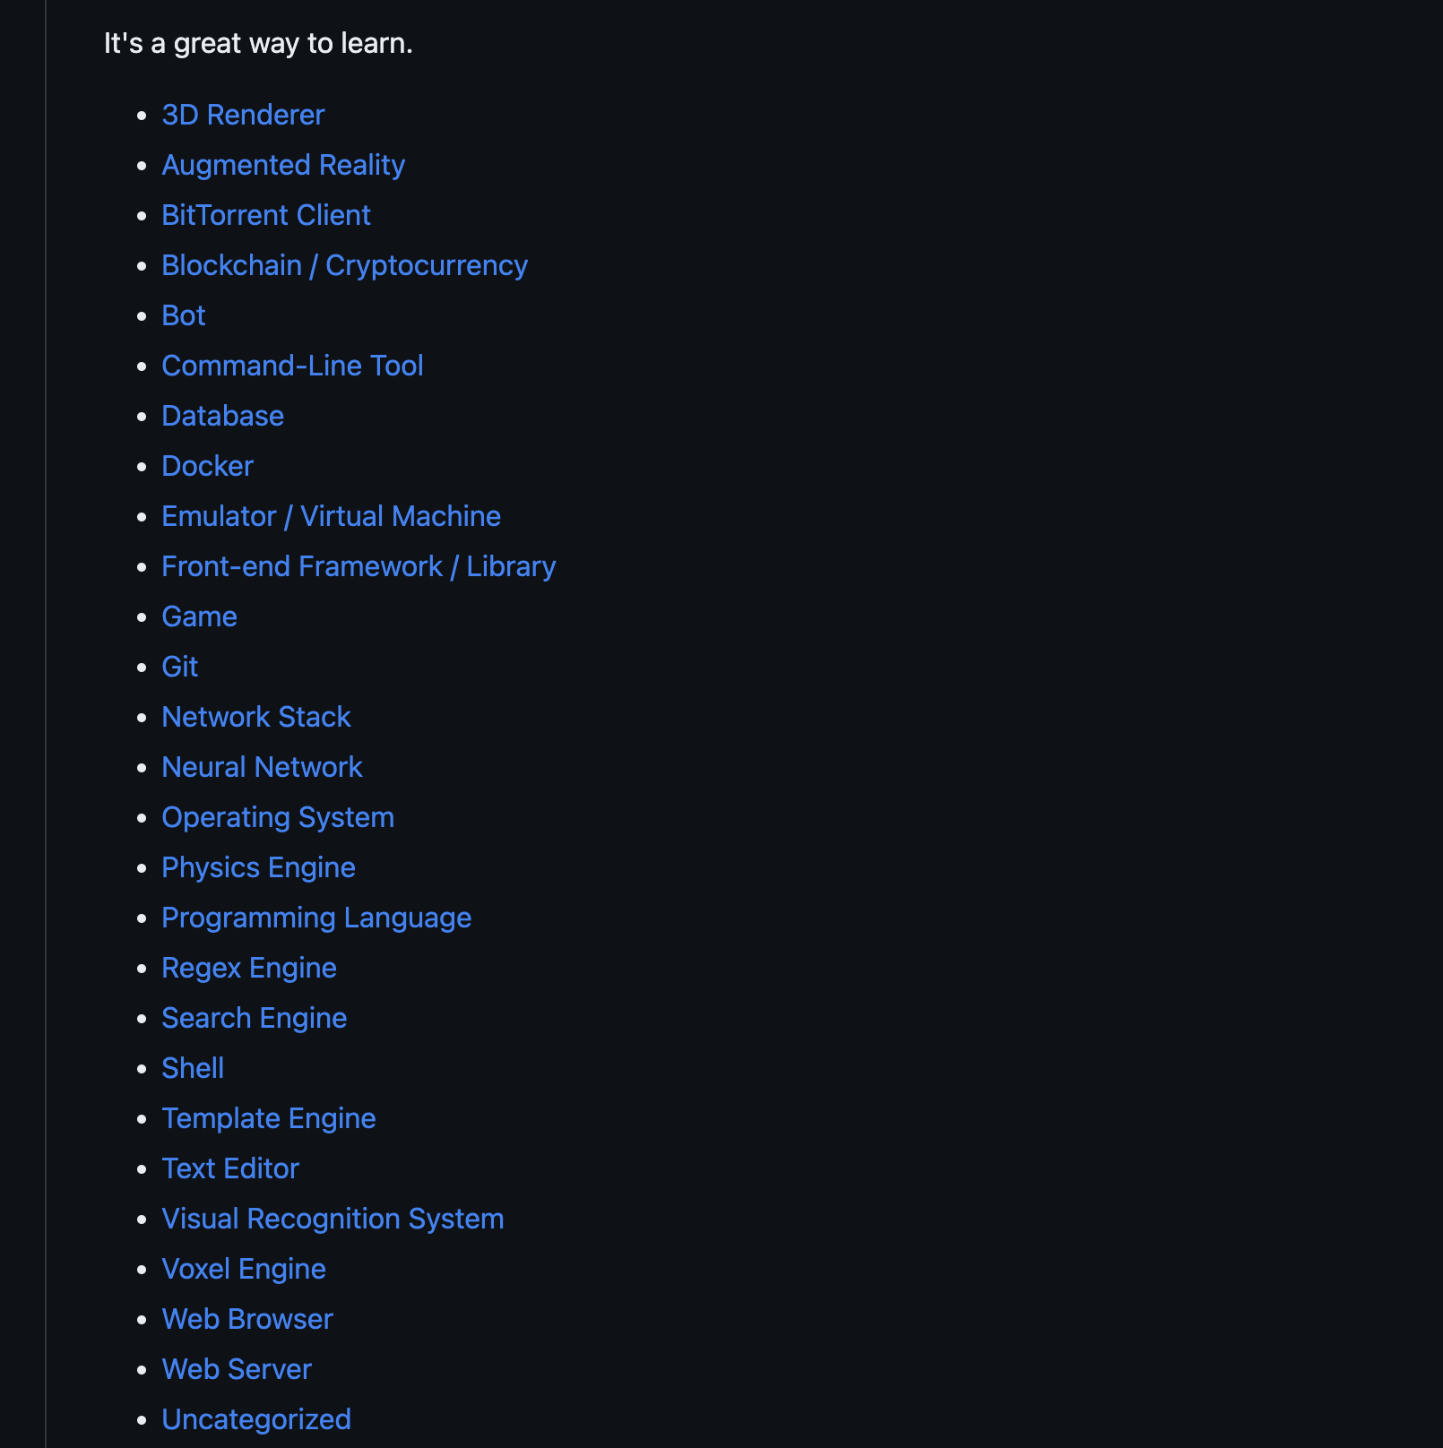
Build complicated projects
Shells
Engines
Games
Git
Your own language
Your own OS
And much more
https://github.com/codecrafters-io/build-your-own-x#build-your-own-shell

Slide 43
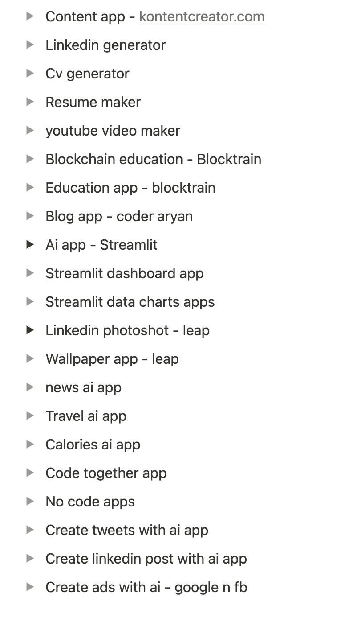
Community projects - 30dayscoding.com
New tech stack
Detailed blogs
Detailed guides
Video resources
Idea to deployment

Slide 44
Product hunt and YC - Startups and products
Frontend, full stack, Blockchain, AI, etc
30dayscoding.com

Slide 45
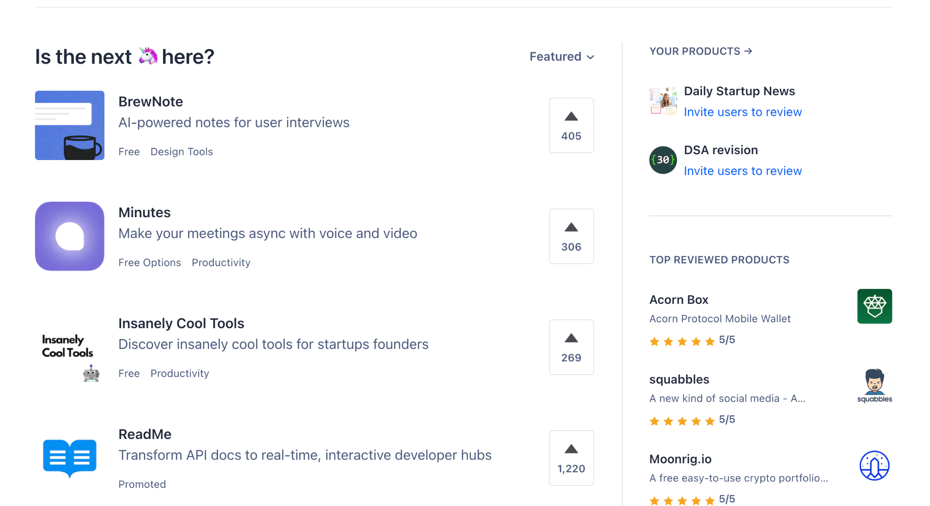
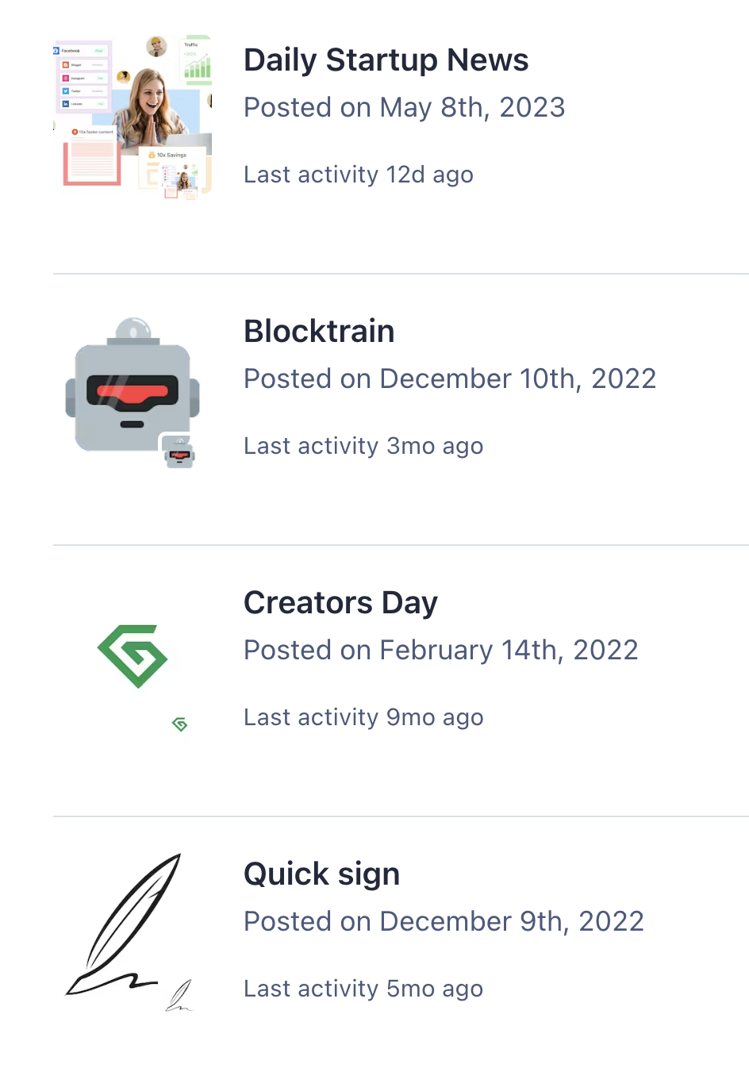
Product hunt - game changer.
Learn from products
Get new ideas
Post your ideas
Help and collaborate

Slide 46
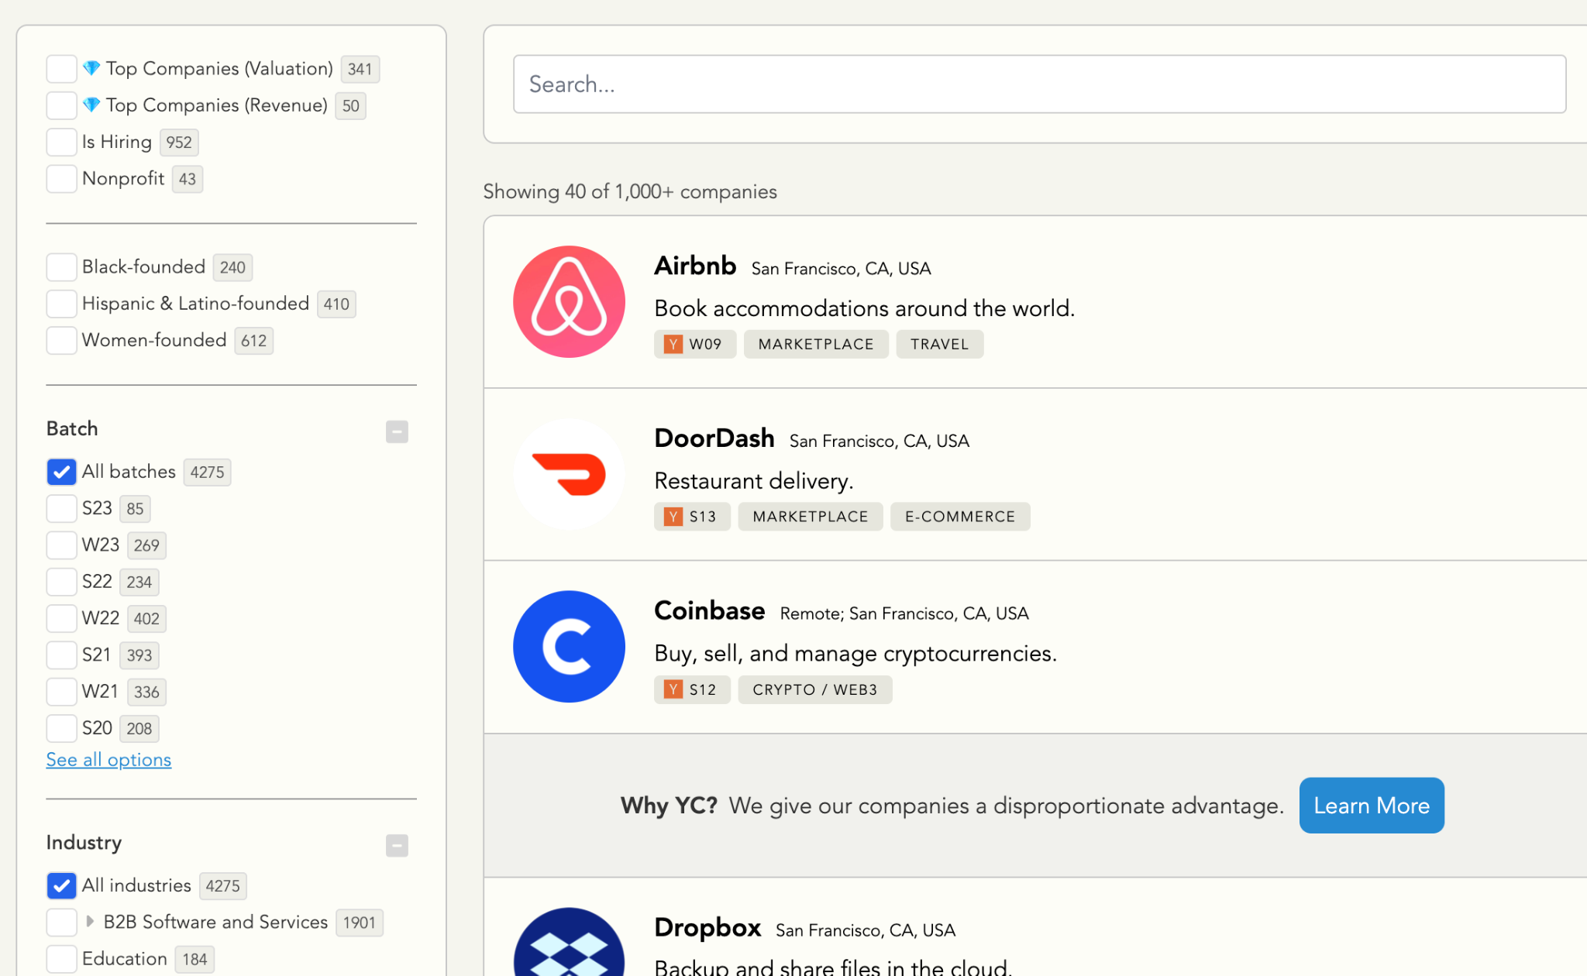
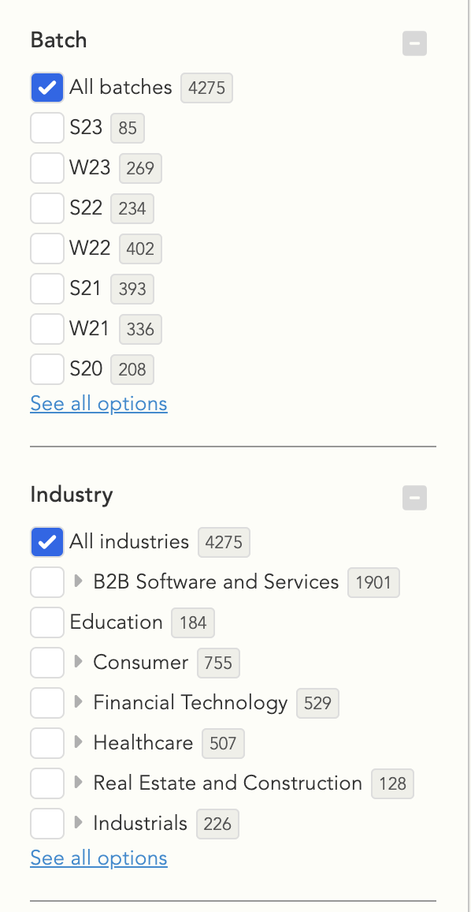
Y Combinator companies - lot of amazing startups

Slide 47
Join our exclusive 24/7 community for $5
Frontend, full stack, Blockchain, AI, etc
30dayscoding.com

Slide 48
Community projects - 30dayscoding.com
New tech stack
Detailed blogs
Detailed guides
Video resources
Idea to deployment

Slide 49
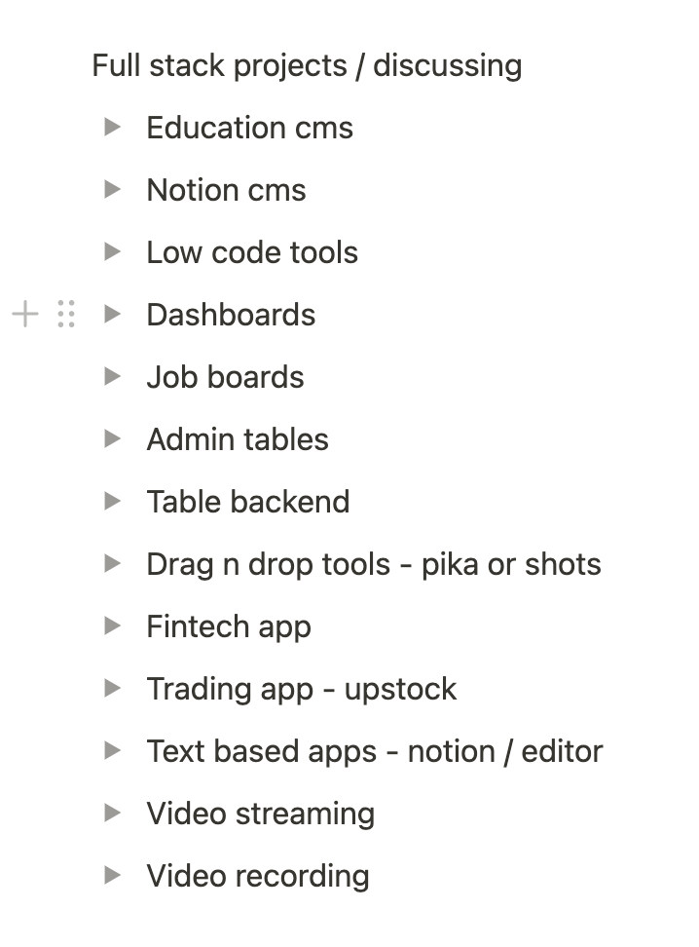
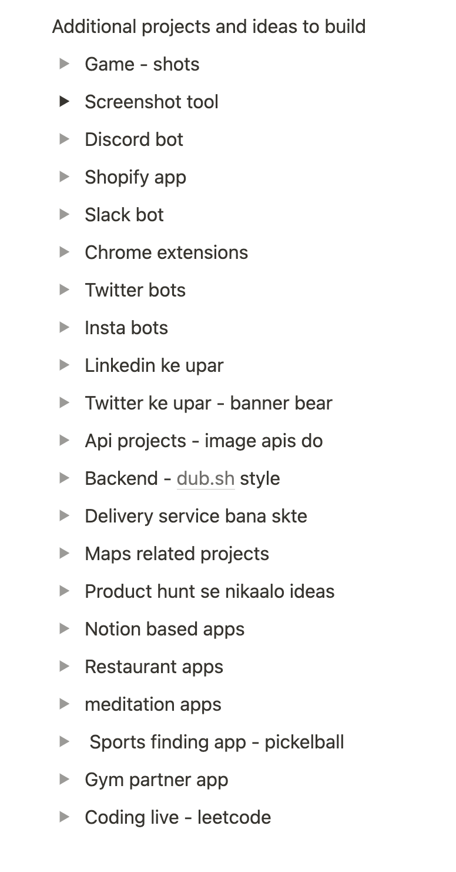
I am discussing all these projects in my community
Join if you’re interested
No need if you can build projects outside
Come if you want to 10x your journey for $5

Slide 51
DSA masterclass
Become a DSA expert + a good problem solver. Tips from experts
30dayscoding.com

Slide 52
Important points
DSA is about problem solving and not just leetcode
Use DSA as your advantage instead of complaining
No need for CP if you are not confident with 200-250 questions
No need of a course if you know the basics
Stop pasting solutions and watching videos without TRYING
Stop comparing your journey to others
No, you don’t need to solve 1000 questions
No, you don’t have to be a born genius
I cleared 40+ DSA interviews and you can too!

Slide 53
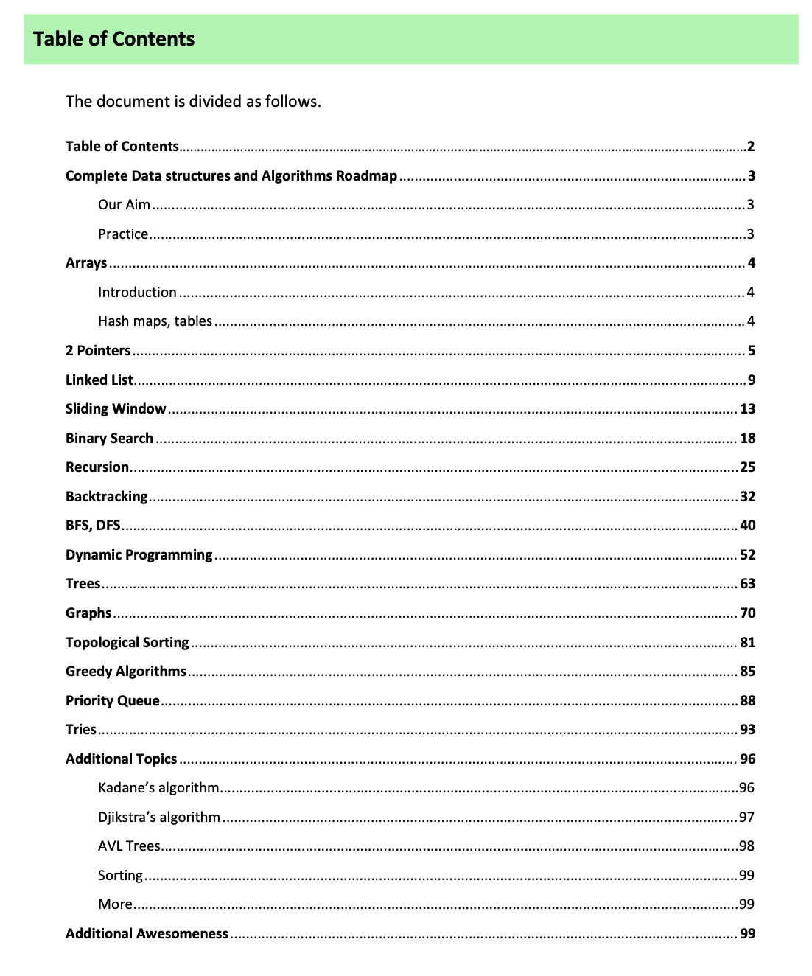
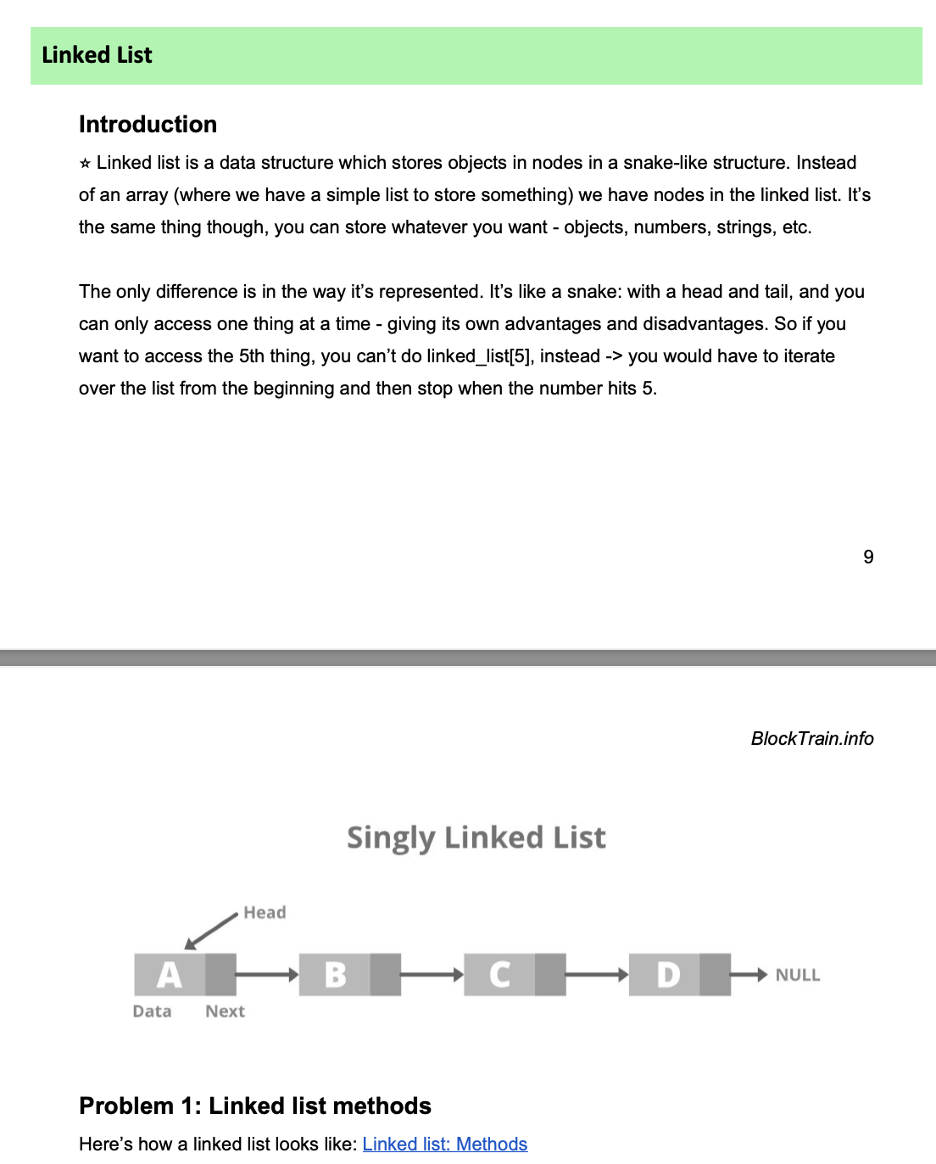

Slide 54
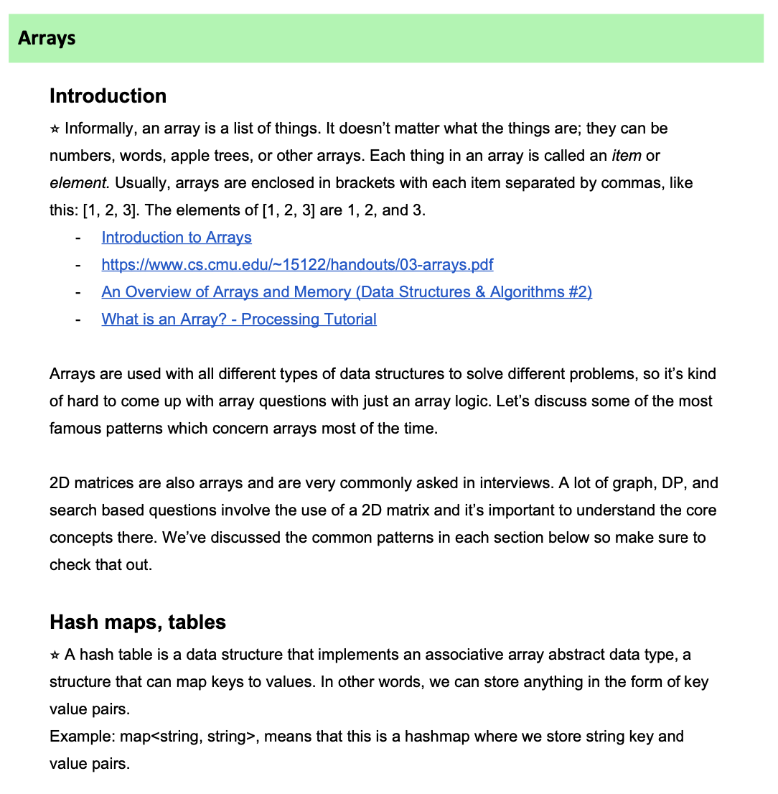
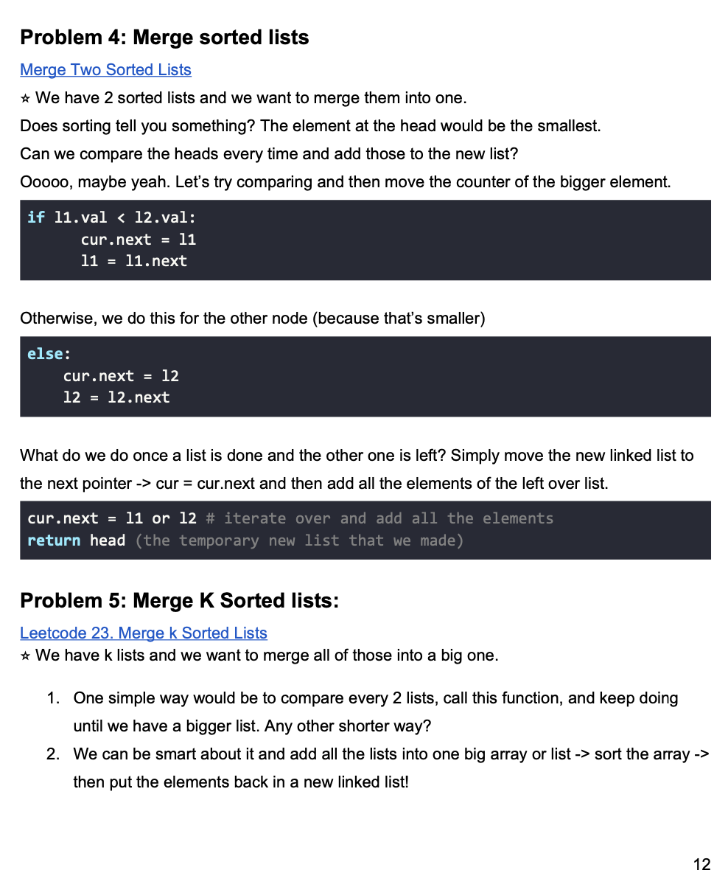

Slide 55
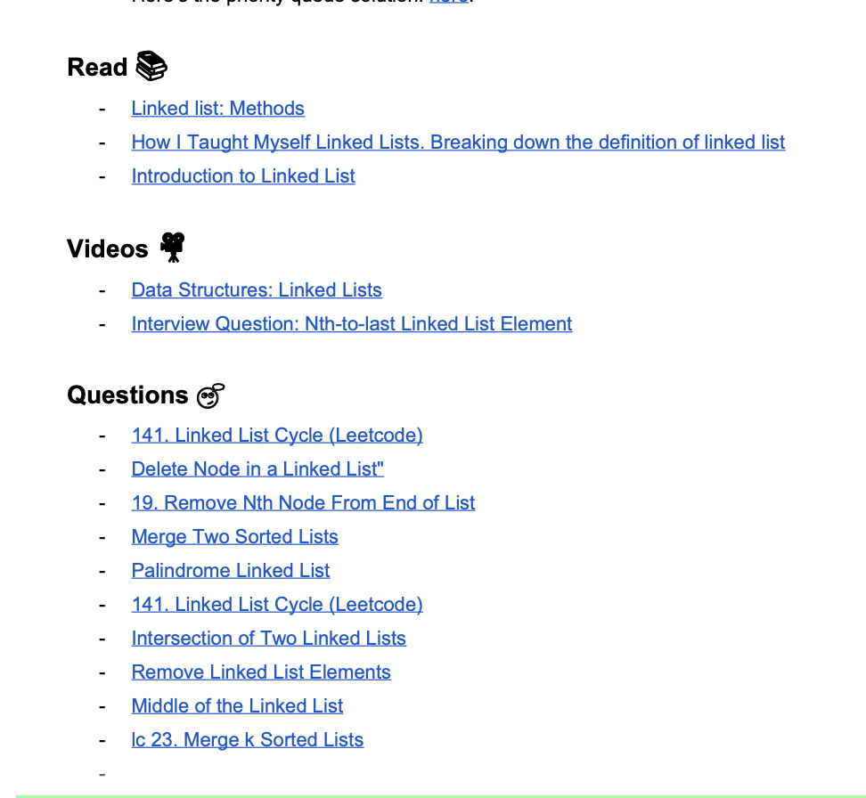
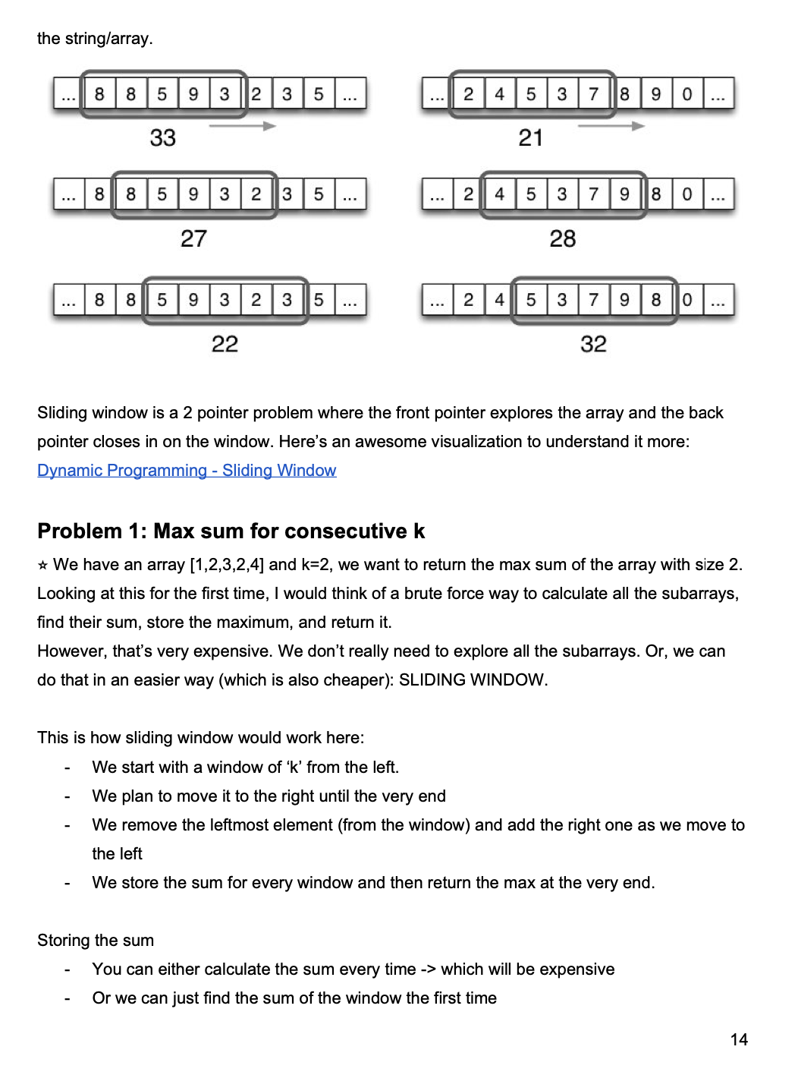

Slide 56
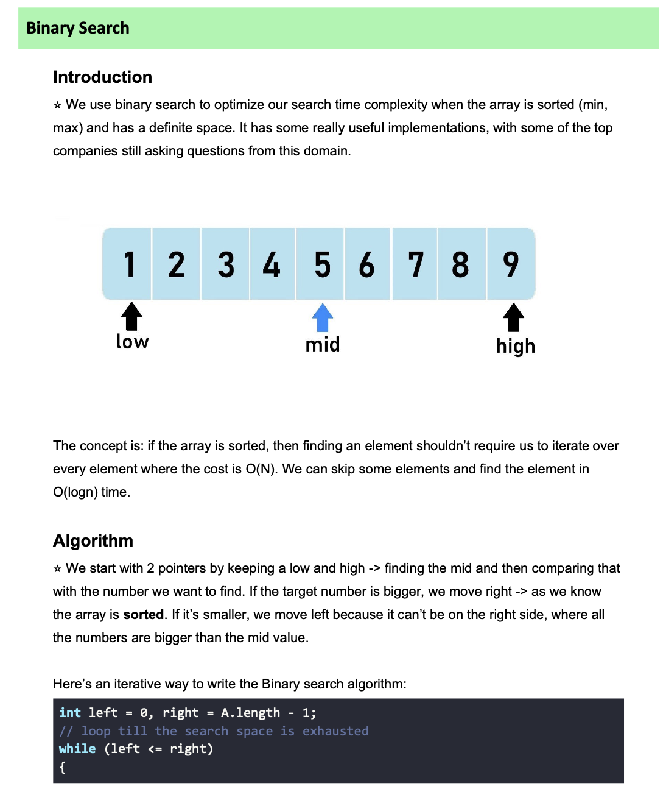
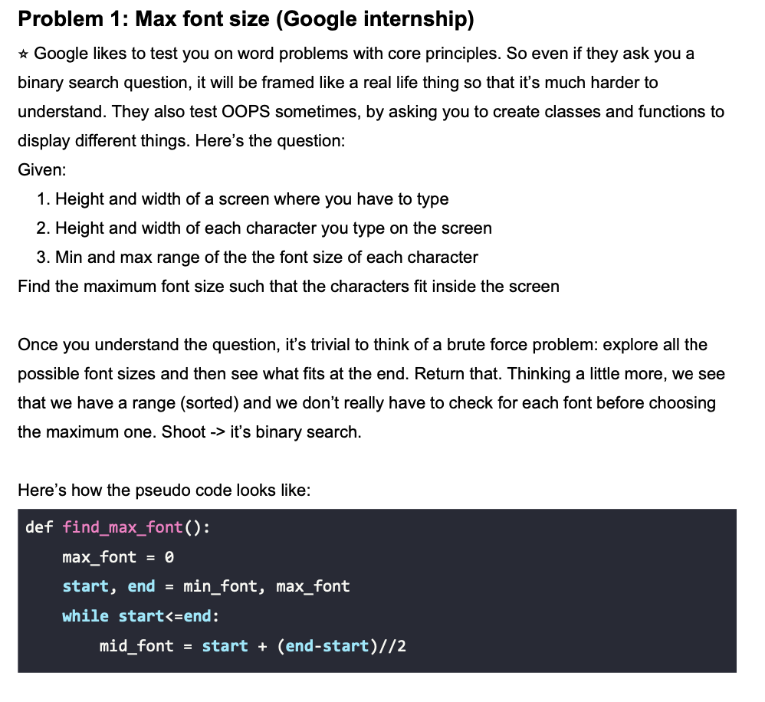
BINARY SEARCH

Slide 57


Slide 58

RECURSION
V v v important topic
Read every line
Understand every pattern
This is the basis for backtracking and DP - 2 very important topics
Don’t skip questions
Make notes
Solve 25+ problems

Slide 59


READ AND UNDERSTAND PATTERNS.
Copy pasting doesn’t help
Reading doesn’t help
Understanding helps

Slide 60


Slide 61



Slide 62

Backtracking is v v important pattern / algo / etc
Used in real life use cases
Finding cheapest flights/shoes/etc
Finding fastest etc
UNDERSTAND THE PATTERN HERE
Push, recurse, pop is a famous pattern
We use the element
Recurse and solve for it
Then remove it
Read every word and line from this.

Slide 63


Slide 64



Slide 65

The most important DFS problem - number of islands.
Use a pen and paper
Make a diagram
Visualize how things are working
Solution
Iterate, change the number
Count the islands
Change it back
Do it for all the indexes

Slide 66


ITERATIVE VS RECURSIVE
SOLVE USING BOTH

Slide 67



Slide 68


Slide 69



Slide 70

https://www.youtube.com/playlist?list=PL_z_8CaSLPWekqhdCPmFohncHwz8TY2Go
Best DP playlist
For hindi - codebix

Slide 71


Slide 72



Slide 73

Graphs
Searches
Finding something
Flights, comparison Qs
Coloring, visited, etc
Cyclic components
Connected components

Slide 74

https://www.youtube.com/playlist?list=PLDV1Zeh2NRsDGO4--qE8yH72HFL1Km93P
William fiset - amazing graph

Slide 75

ADDITIONAL TOPICS - IMPORTANT

